Slide 1


Step-by-Step Guide for the Exit Interview and Input into the PSO App
The PSO EXIT INTERVIEW
Revised 1/2024

Slide 2
Objectives
EXIT INTERVIEW
Understand the Importance of the PSO Exit Interview
Know Who Participates in the Exit Interview
Learn What the Process is for the Exit Interview
Use the PSO 2.0 Application Step by Step Guide to Understand the Exit Interview Process
2
Notes:
PSO Application training – the major functions of the PSO application, how to navigate, how to enter data, etc.

Slide 3

Why Complete an Exit Interview?
The Exit Interview…
Is crucial for obtaining contact information for the Follow-Up Interview.
Increases response rates for the required Follow-Up Interview.
Provides an opportunity to engage the student and family in the PSO process.
Encourages a discussion with students about their future plans and allows time to share resources for their future use.
Allows time to connect with student to explain the Follow-Up Interview that’s conducted one year after exit.
Lets students identify a preferred staff member they prefer to do the Follow-Up interview with.
3

Slide 4

Who is eligible for an EXIT Interview?
Students ages 16-21 leaving high school with a regular, modified, or extended diploma, an alternative certificate, reaching maximum age, or who are dropping out of school; and
Had an IEP in effect when they leave school.
Agreement To Participate is necessary from the
Parent/Guardian when the student is 17 years old or younger, or
Student if they are 18 years old or older.
4
Notes:
Signed agreement to participate is required to interview students still in school.
Documents can be found on the website, traqnsitionoregon.org under PSO Resources.

Slide 5
Exit Interview Process
BEFORE THE INTERVIEW:
Obtain an Agreement to Participate
Review student file information for demographic and contact information
Get access to and become familiar with the PSO 2.0 App
Enter demographic and contact information at any time before the interview
Set up an interview time - best would be within one month of student’s anticipated exit
DURING AND AFTER THE INTERVIEW:
Complete the interview electronically while using the PSO App
Have student complete the address portion of the PSO Postcard in person
Collect multiple forms of contact information for Follow-Up Interview and enter them into Exit Interview on PSO App; these contacts will pre-populate the Follow-Up Interview
Explain the upcoming Follow-Up Interview and answer any questions ; give the PSO Interview Guide for Student and Family as a resource
Update the interview if new information emerges (contact info, new goals, etc.)
Confirm ALL interviews complete with no need for further edits by clicking Mark Collection Complete
5
Notes:
Application, PSO Postcard, Interview Guide for Student and Family, other PSO documents are all found on the transitionoregon.org website: https://transitionoregon.org/post-school-outcomes/exit-interview/

Slide 6

Agreement to Participate
Agreements to Participate and other resourses
Found on Oregon Transition Education website:
https://transitionoregon.org/post-school-outcomes/exit-interview/
Agreement to Participate:
Parent/Guardian Permission for Students ages 17 and younger to
Participate in Oregon’s Post-School Outcomes Exit Interview
Dear Parent/Guardian
A year after your student leaves high school, someone from the school district would like to call them, or you, to learn what they have been doing since leaving high school. They will ask about your student’s work and school experiences in a Follow-Up Interview. This data collection is done by all states and is known as the post-school outcomes collection, or PSO. To be able to contact your student, we would like to conduct an Exit Interview with them before they leave school. The purpose of this letter is to tell you about the PSO collection and request permission to conduct an Exit Interview with your student before they leave school.
Agreement to Participate:
Permission for Students ages 18 and older to Participate in
Oregon’s Post-School Outcomes Exit Interview
Dear Student
A year after you leave high school, someone you know from the school district would like to call you, or your family, to learn what you have been doing since leaving high school. They will ask about your work and school experiences in a Follow-Up Interview. This data collection is done by all states and is known as the Post-School Outcomes collection, or PSO. To be able to contact you, we would like to conduct an Exit Interview with you before you leave school. The purpose of this letter is to tell you about the PSO collection and request your permission to conduct an Exit Interview with you before you leave school.
Or, click the button from the previous page
6

Slide 7
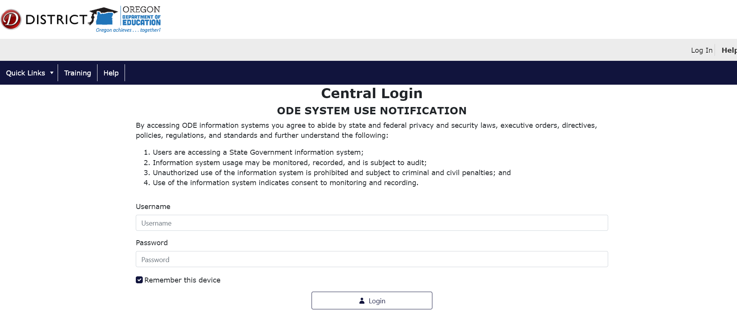
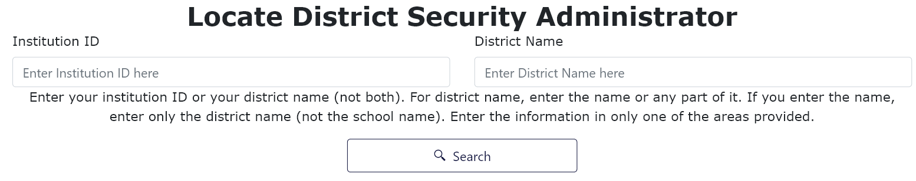
PSO App 2.0 Access
FOR FIRST-TIME USERS
Get permission from your SpEd or Student Services Director to access the PSO 2.0 Application
Locate your district security administrator for a password to access the application
  Request submitter and modify rights for the application Special Ed Post School Outcomes 2.0
Access the secure district site: https://district.ode.state.or.us/apps/login/searchSA.aspx
Enter either your district name or Institution ID, this will allow you to search for your specific District Security Administrator who will give you your user name and password to login to the PSO Application (see next slide)
7

Slide 8
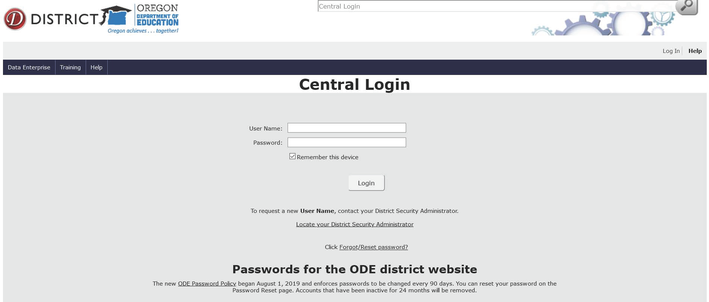
PSO App 2.0 Access
FOR REPEAT USERS
Gain access to your District site at https://district.ode.state.or.us/apps/login/default.aspx
Log in with user name and password
Click on: Special Ed Post School Outcomes 2.0-Oregon Department of Education
Gain access to your District site at https://district.ode.state.or.us/apps/login/default.aspx
Log in with user name and password
Click on: Special Ed Post School Outcomes 2.0-Oregon Department of Education
Gain access to your District site at https://district.ode.state.or.us/CentralLogin
Log in with user name and password
Click on: Special Ed Post School Outcomes 2.0-Oregon Department of Education
2.
2.
3.
1.
8

Slide 9
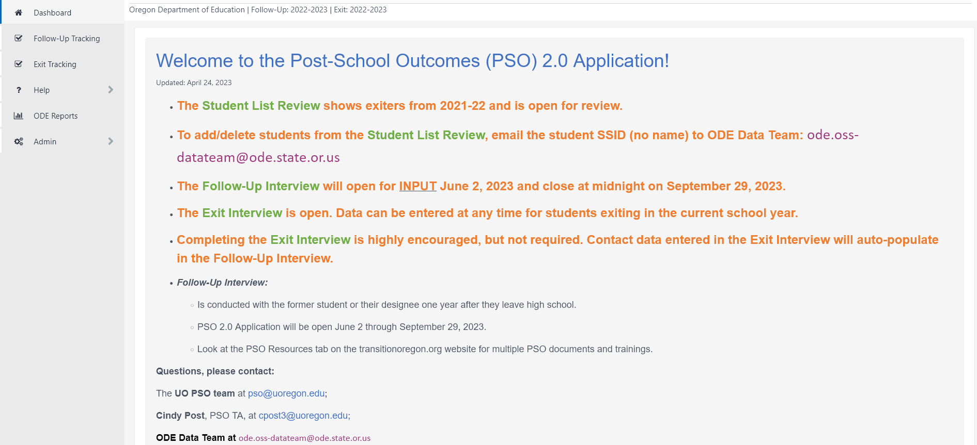
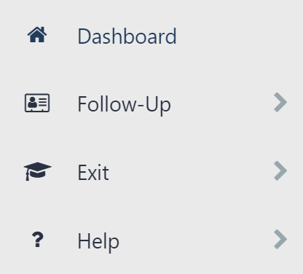
Welcome to PSO 2.0 App Home Dashboard
The navigation index on the left has four tabs: Dashboard, Follow-Up, Exit, and Help. Below is the HOME Dashboard. Each section tab has a Dashboard. Watch the Dashboards for updated information. The contents for each tab is shown below the Dashboard.
Follow-Up:
Dashboard
Reports
Exit:
Dashboard
Reports
Help:
FAQs
Resources (links)
9

Slide 10
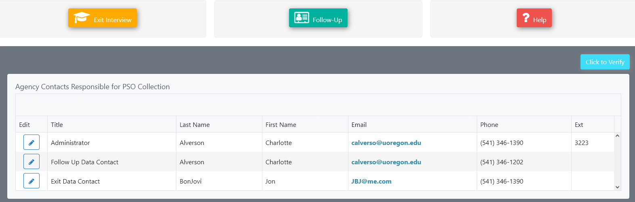

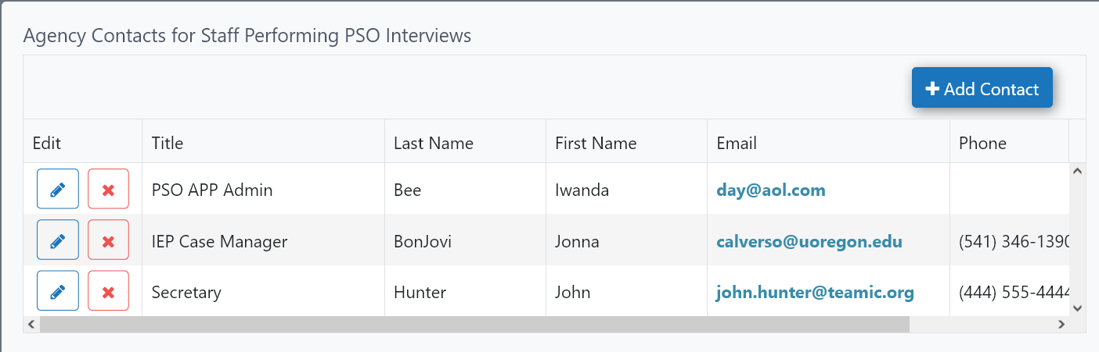


Home Dashboard and Navigation to the Exit Interview
If you continue scrolling down on the HOME Dashboard, please add your district/school contact information as well as contact information of the people that collect and/or input the data. When finished, click the
button to verify
before moving on.
To get to the interview portion, you can open the Exit Interview either with the
button OR
by clicking on the Exit Dashboard Index.
10
Notes:
Here is where you can add your district/school contact information – both Administrative and those responsible for interviewing and/or input of the Exit/Follow-Up Interview

Slide 11
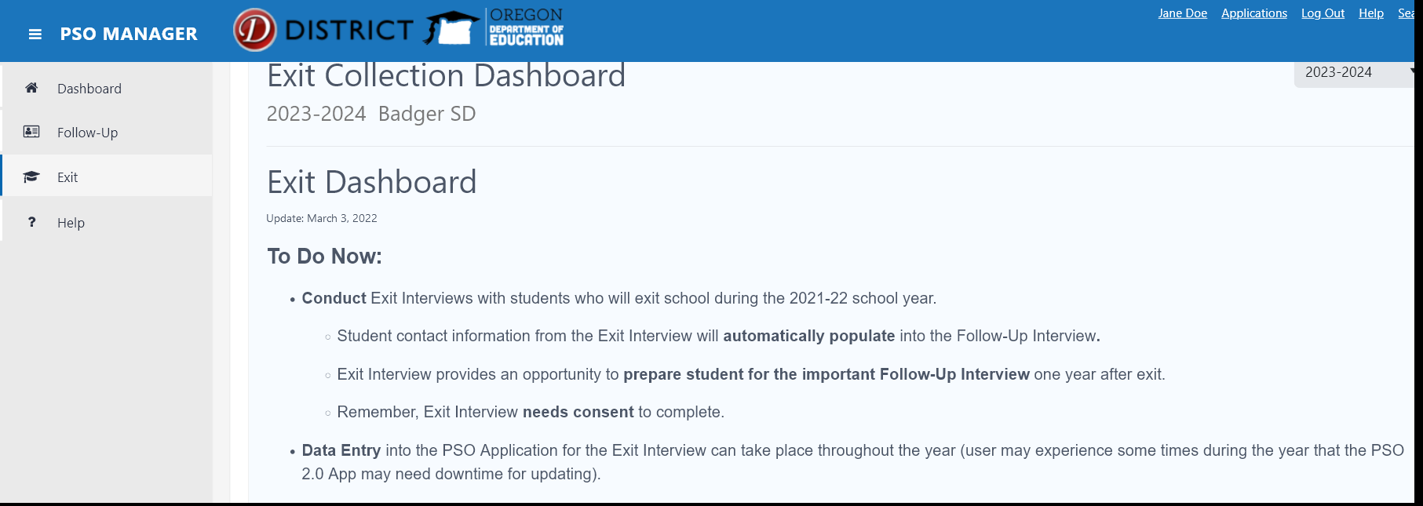
Exit Dashboard
REMINDER: Prep for Data Entry for the Exit Interview
Agreement to Participate forms need to be signed before proceeding with the Exit Interview
Contact information can be gathered all year long, a good opportunity would be during the student IEP meeting – this is a valuable tool when doing the Follow-Up interview.
Exit Interview data can be submitted All year long in the PSO App – downtime may occur on occasion
Once data are entered, the interview can be accessed again for edits
11

Slide 12
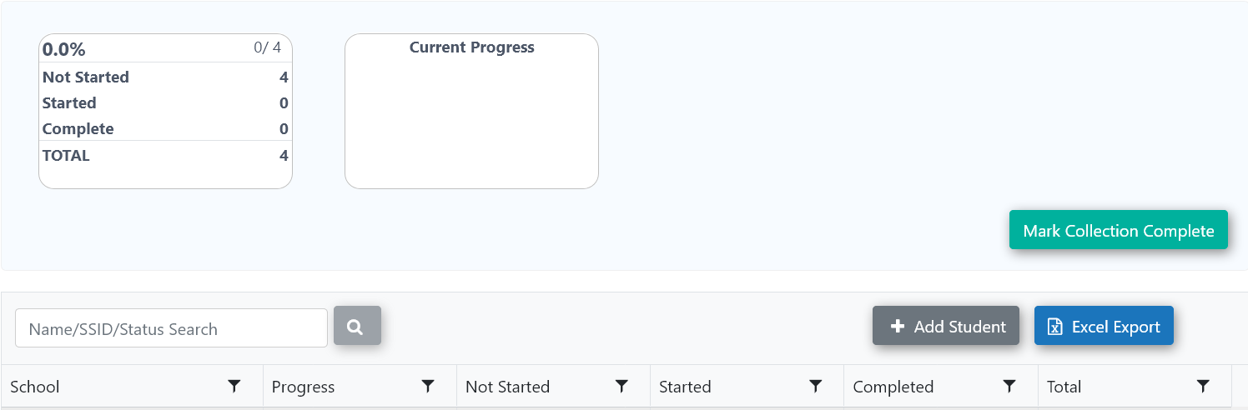
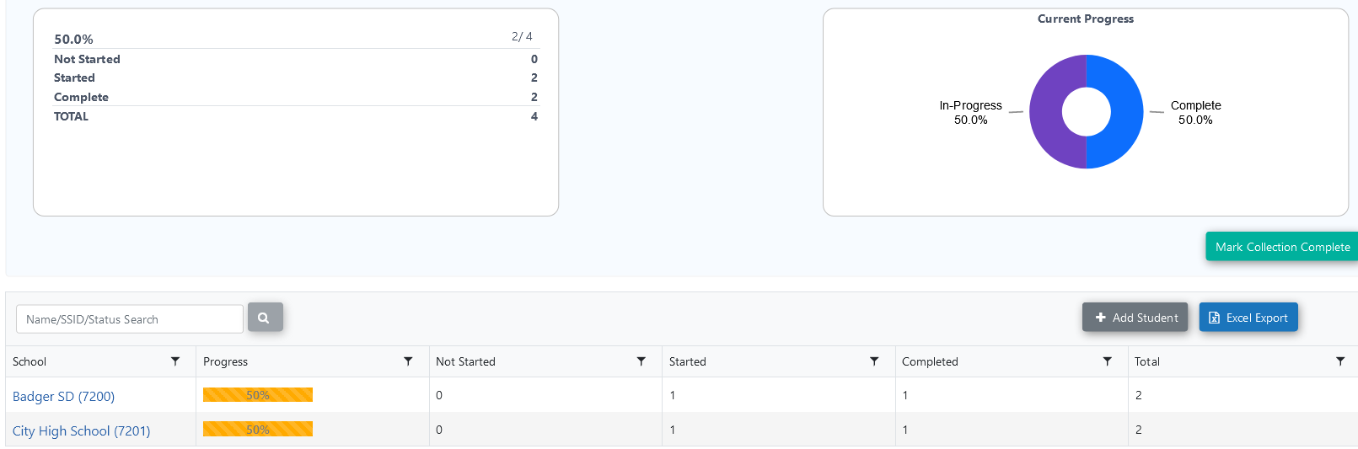
Exit Dashboard
The Exit Dashboard screen will show access to add new students, allow Search by Student SSID# or Name, and show progress of your District’s Student Exit Interviews once entered.
From this - (before data input)
To this -
(after data input has begun)
12

Slide 13
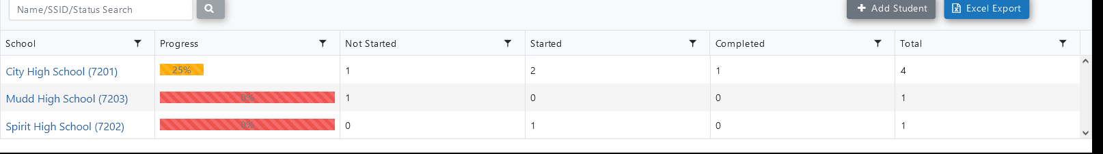
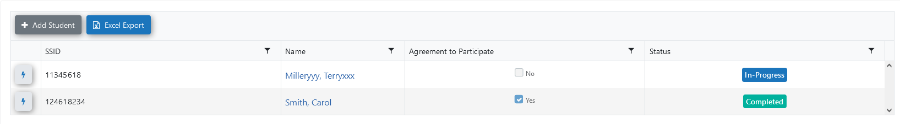
Adding Students from the Exit Dashboard
Click on the High School name (Mudd HS, above) to begin the interview input.
To start, there will be no students listed, each student has to be added.
The view (below) will show each student that has been added, if the Agreement to Participate has been signed and Student Interview Status (Incomplete, Started, In-Pregress, Completed).
13

Slide 14

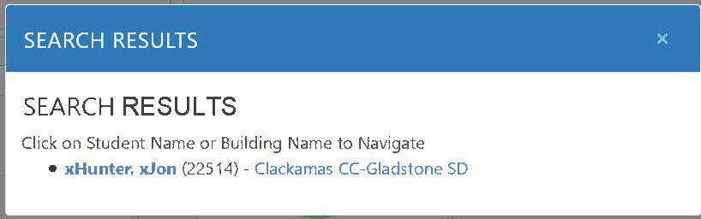
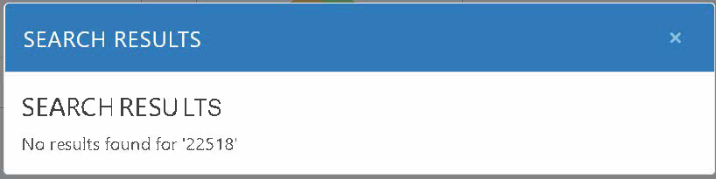
Search for Student
If you need to search for a student, you may use the search button in 2 ways.
If Found, a screen will appear -
Click on name and continue to Interview
By Name
OR
If NOT Found, a screen will appear - Go back and +Add Student
By SSID
14

Slide 15
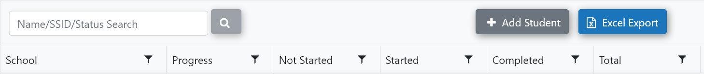
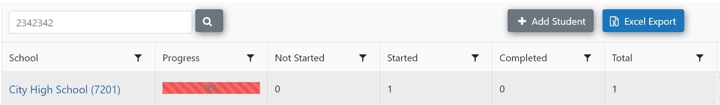
Adding a New Student
Adding Students from the Exit Dashboard:
Once you enter the Exit Dashboard, you will begin to develop your District/School list for the Exit Interview.
To search for a student, enter the Secure Student Identifier Number (SSID) or name and click search button. You will have to populate the student’s record (name, school, gender, birthdate).
You can now click on your school name. Continue to add students by clicking the Add Student button. With each student added, your list will begin to grow.
Or, click the button from the previous page
After adding student, confirm information is correct and press Save to continue
15
Notes:
Enter the student’s SSID # or name and then it will populate. Confirm the information is correct and press Save

Slide 16
Process If No Student is Found
If the PSO App cannot locate your student, you will need to contact the
ODE Data Team for assistance.
Please send the SSID# (no name for security reasons) in an email request to:
ode.oss-datateam@ode.state.or.us

Slide 17
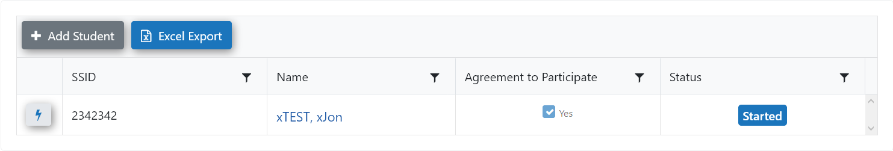
Enter Exit Interview for Input
Click on student name to enter Interview portion
Continue to add students as needed
Reminder, don’t forget to obtain the Agreement to Participate
Documents are found on transitionoregon.org website under PSO Resources/Exit Interview
16

Slide 18
3 Sections of the Exit Interview
A
Demographics and School Participation-can be completed prior to the student interview and without Agreement to Participate D1-15
Can be entered at any time before the actual student interview
B
Student Interview Questions – CANNOT be completed without an Agreement to Participate Q0-12
Remember – QC1 asks the Name of the Preferred Follow-Up Interviewer,
Please have student answer this question at the end of the interview.
C
Contact Information – can be completed prior to the student interview and without Agreement to Participate, ONLY IF it is information the district already has, otherwise, you will need a signed agreement for the student to answer and provide new contact information. C1-15
17

Slide 19
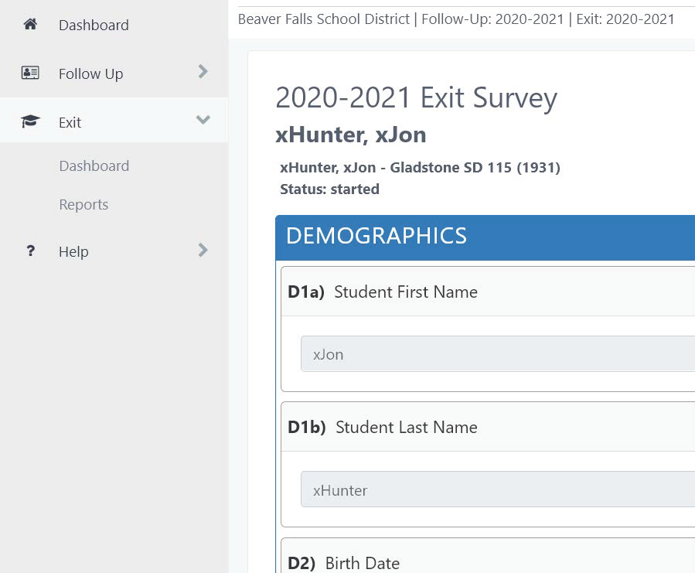

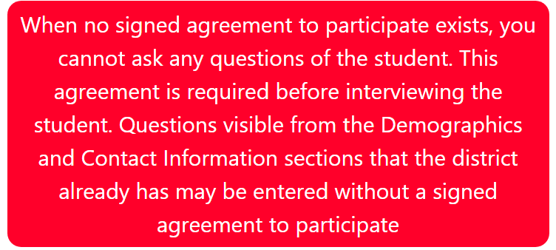
Demographics-Section A
Once in the survey, again, both the Demographic and Contact sections can be entered at any time. If you want to continue with the student interview, you have to have an Agreement to Participate on file.
When you come to the D12 question, (see below)
Does the student/parent/guardian agree to participate?
If the answer is no, or not sure, you will see this… and, you will not have access to the Q. section, the student interview section, that section will NOT appear for input until you have the Agreement to Participate on file and can answer Q12 as Yes
If Yes, please proceed…
18

Slide 20
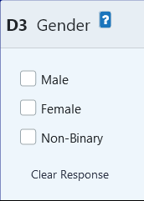
Demographics Section A
Descriptor Button
In the Demographics section only, you may come across a question button.
Once clicked, a short description will be revealed regarding the demographic question;
re-click to remove the provided explanation, see examples below:
D7: Anticipated Method of Exit D12: Does the student/parent/guardian agree to participate?
?
For students in transition programs, this should be the student's actual method of exit.
If the student is 18 or older, they must sign an agreement
to participate, otherwise their parent/guardian must
sign an agreement to participate.
19

Slide 21
Student Interview Questions Section B
STUDENT FUTURE PLANS
In the first part of this B-section, you will encounter Questions 1-11. These are mostly regarding the student’s future plans.
Interview must be completed with the student
This interview may occur with parents during an IEP meeting
Allow this interaction to prepare the student and family for the required Follow-Up Interview that will happen one year after exit from high school
20

Slide 22
Student Interview Questions Section B
AGENCIES AND SERVICES
The final questions of this student interview are Questions 12a-12g.
These questions are directed towards the student’s knowledge of agencies and services for assistance.
Assist the student with any future needs or questions regarding agencies and services
Have resources available to be able assist students with services in their future
Remember – QC1 asks the Name of the Preferred Follow-Up Interviewer,
Please have student answer this question at the end of the interview.
21

Slide 23
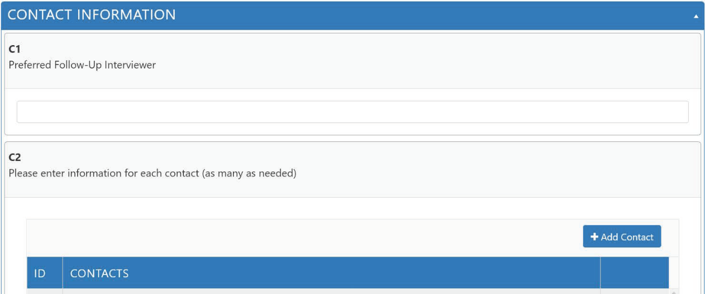
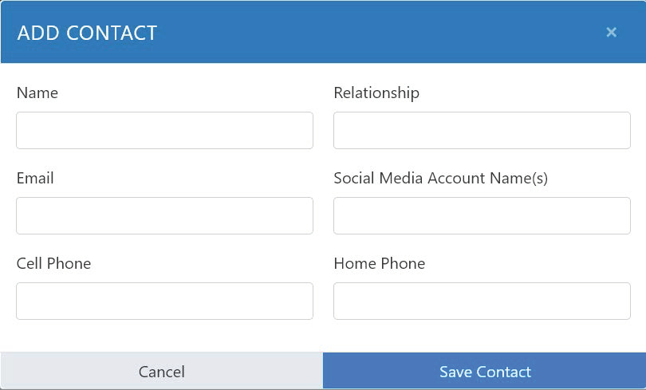
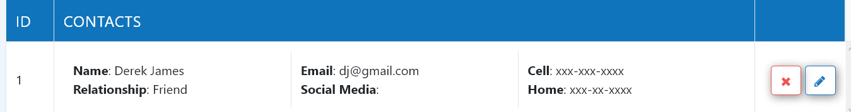
Contact Information Section C
CONTACTS Section, C1-C5
Have the student continue with this section-their input will be extremely helpful
Beginning with the student and carrying through to a close friend, contacts are a VERY IMPORTANT part of the Exit Interview
This collection will provide helpful contact information for the Follow-Up Interview
Collect as much information as you can during this opportunity
An additional question to ask is:
Is there someone in particular you would like to choose to conduct your Follow-Up Interview? Enter name into Preferred Follow-Up Interviewer (C1)
Remember – to complete this question
Remember to click after each addition
Save Contact
This is result the of adding Contact info
22

Slide 24

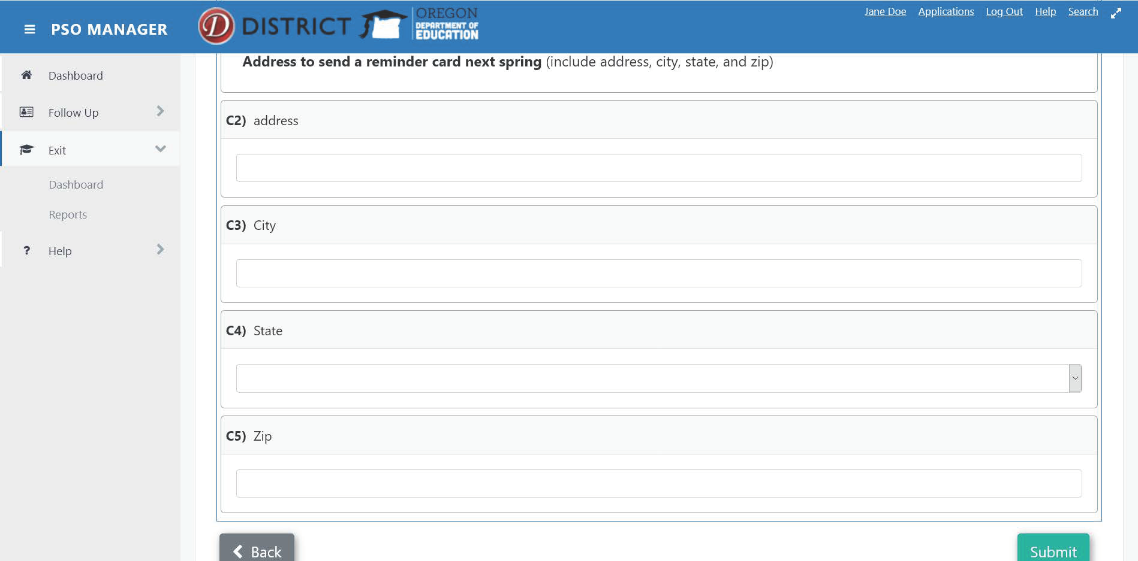
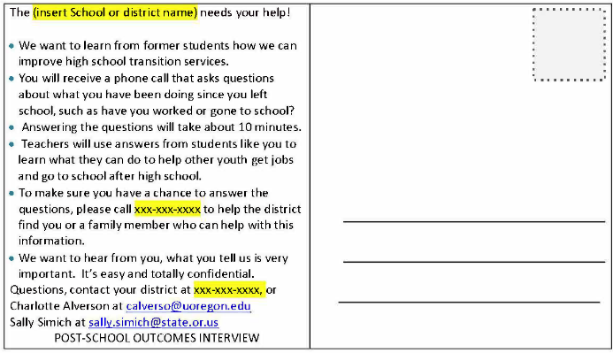
Contact Information Section C
Enter the Postcard information in the App
The PSO Postcard
Introduce the student to the postcard
Familiarize student with the item that will remind them of the upcoming important Follow-Up Interview
Have them personally address a PSO postcard to themselves
Postcard link found on PSO App under Help/Resources with link to: transitionoregon.org
23
Notes:
While still in school, discuss the upcoming Follow-Up Interview with students
Share what district has learned from past students and how their input can be helpful in the future
Have students complete the PSO postcard to themselves

Slide 25
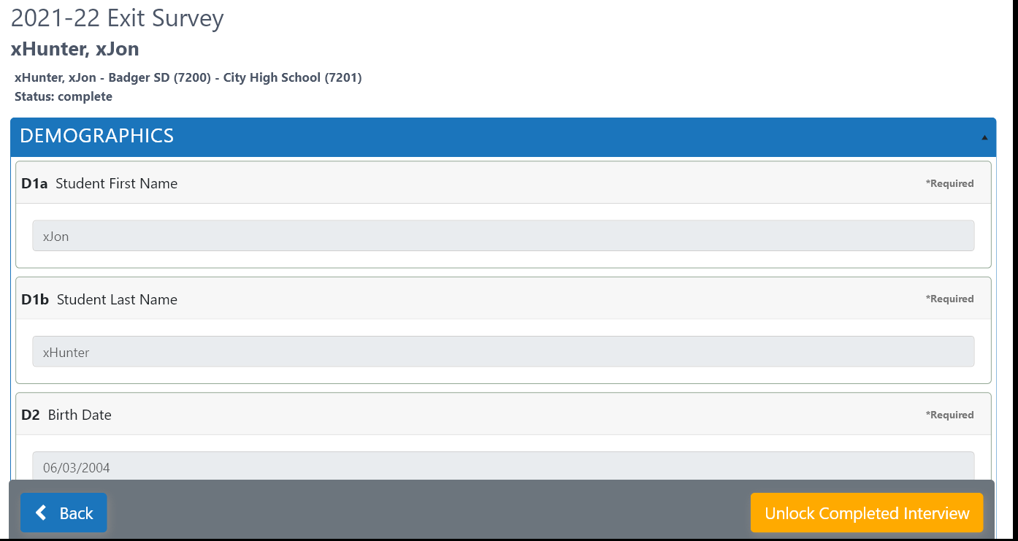
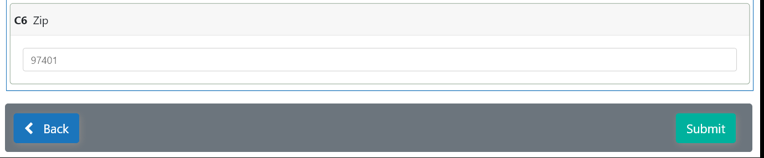
Edits to Exit Interview
If you find you need to make necessary edits to your Exit Interview, just click Unlock Completed Interview and proceed with your edits.
You CANNOT edit SSID# or Attending School ID – all other data can be edited.
After editing, click Submit once again.
2022-2023
24

Slide 26
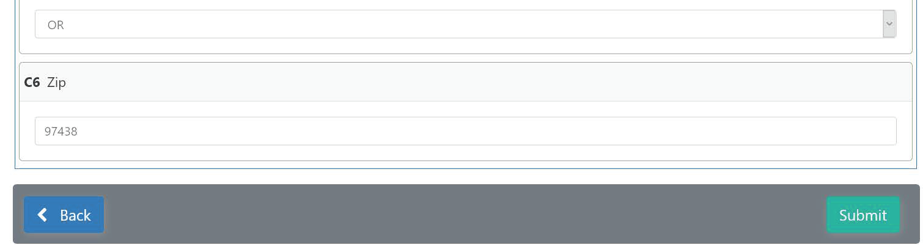
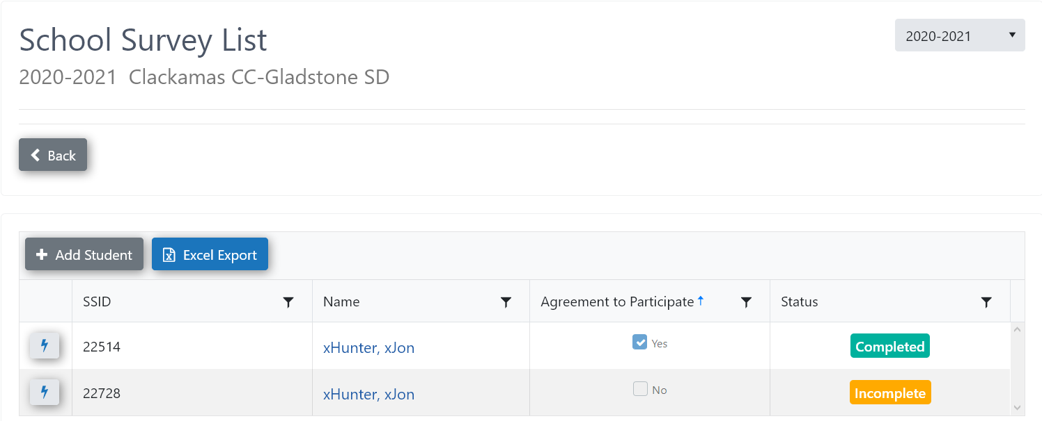
Submission Process
Submission of Information:
When you are totally complete, click
Submit
If you need to return and continue working on your interview, you can return and do so by clicking on your student name and continuing
2022-2023
2022-2023
Use the Back button to return to the main Dashboard, your interview record will show Incomplete for this student
< Back
After completing and submitting your interview
You can return to your interview for any edits or updates that are needed
To do so, click
and proceed with edits or revisions
Click button when done
Unlock Completed Interview
Submit
25

Slide 27
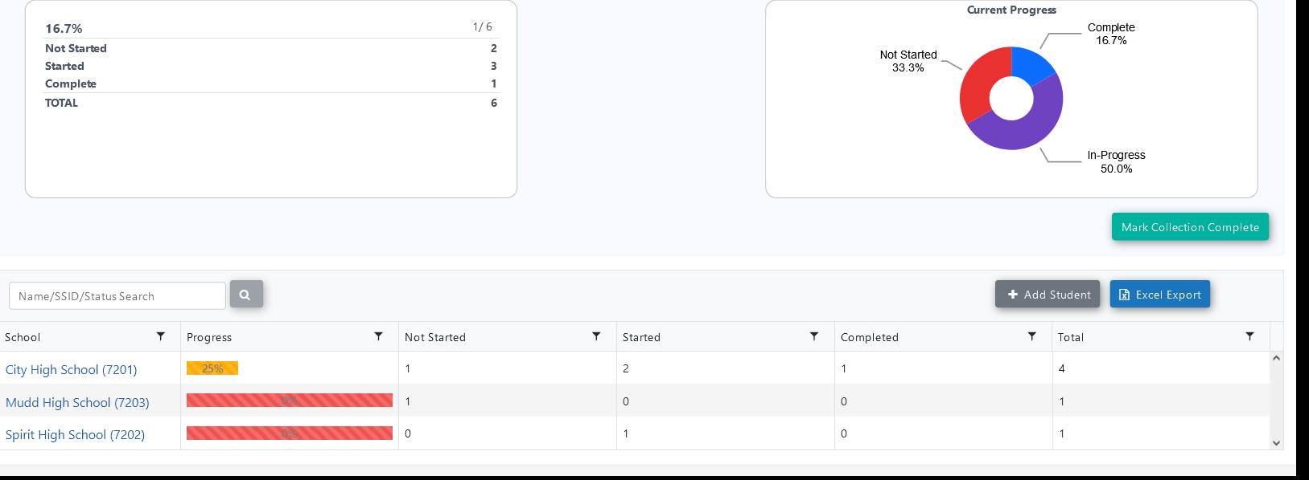
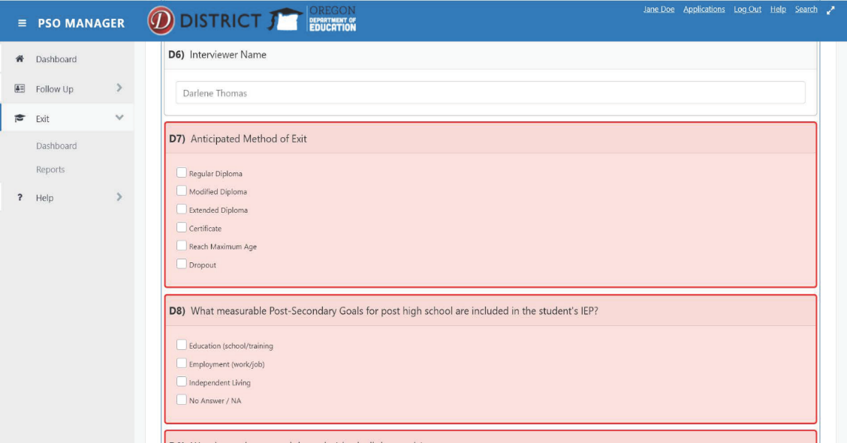
Submission Process
If you see the questions highlighted in red (as below), this may indicate one of the following issues:
Completion needed
Saving or submitting is necessary
Interview is closed and needs to be unlocked to complete
If completing all of the questions does not
resolve this issue, please ask for assistance
District Progress Bar – % of total students entered, will show for individual schools.
District progress will show in pie chart.
Completed
Started
Not Started
Total
2022-2023
26

Slide 28
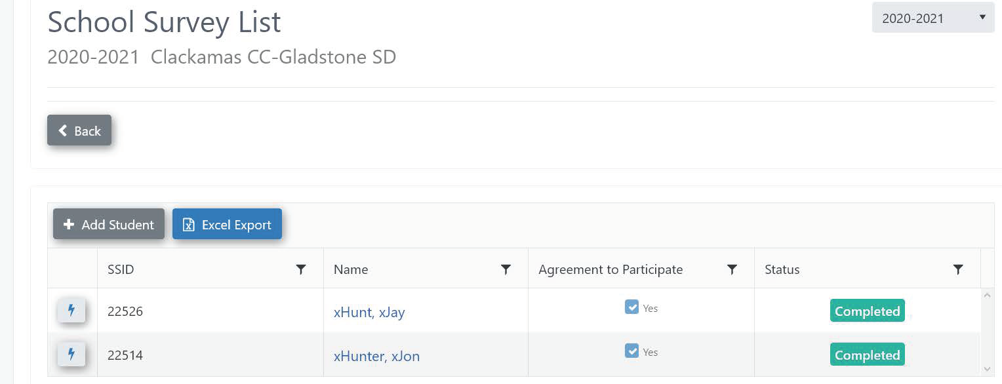

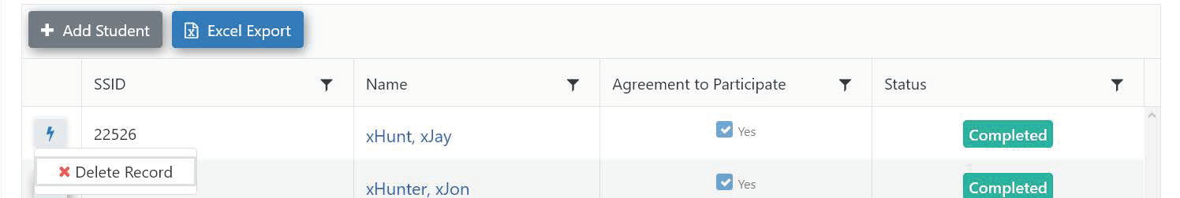
Submission Process
Upon final review, if you see a duplicate or a need to delete a file, please follow the 2 steps below:
2022-2023
2022-2023 Badger SD
Please click on the button
Click the button; a button will appear, click to delete this file
X Delete Record
27

Slide 29
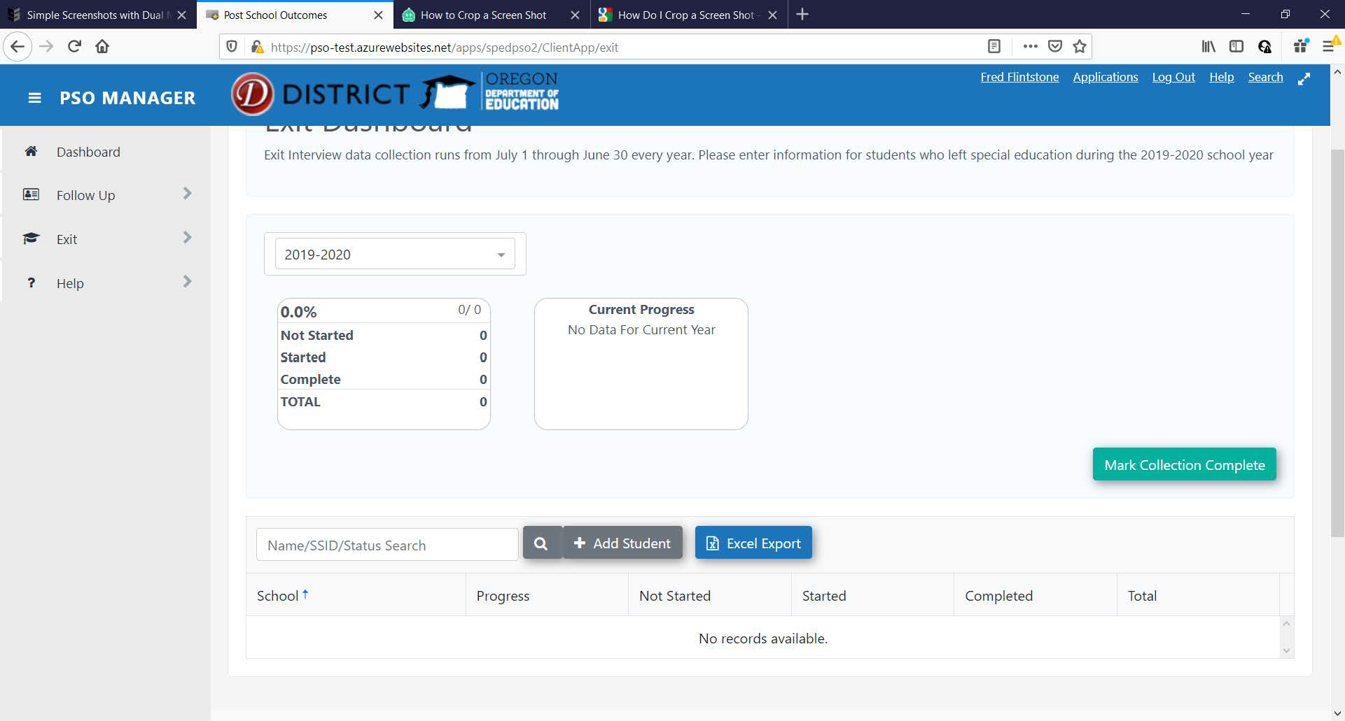
Submitting ALL Completed Exit Interviews
Completion of ALL input:
Check to make sure all students who are going to be interviewed are input completely
Delete any interviews that have been duplicated
Once your district lead has confirmed completion, and you will no longer plan to make any changes to an interview, click
for the current year
Once this has been submitted, edits or updates are not possible
2022-2023
Mark Collection Complete
If you click the Excel Export button, you have access to download an excel file of all students’ interview data
28

Slide 30
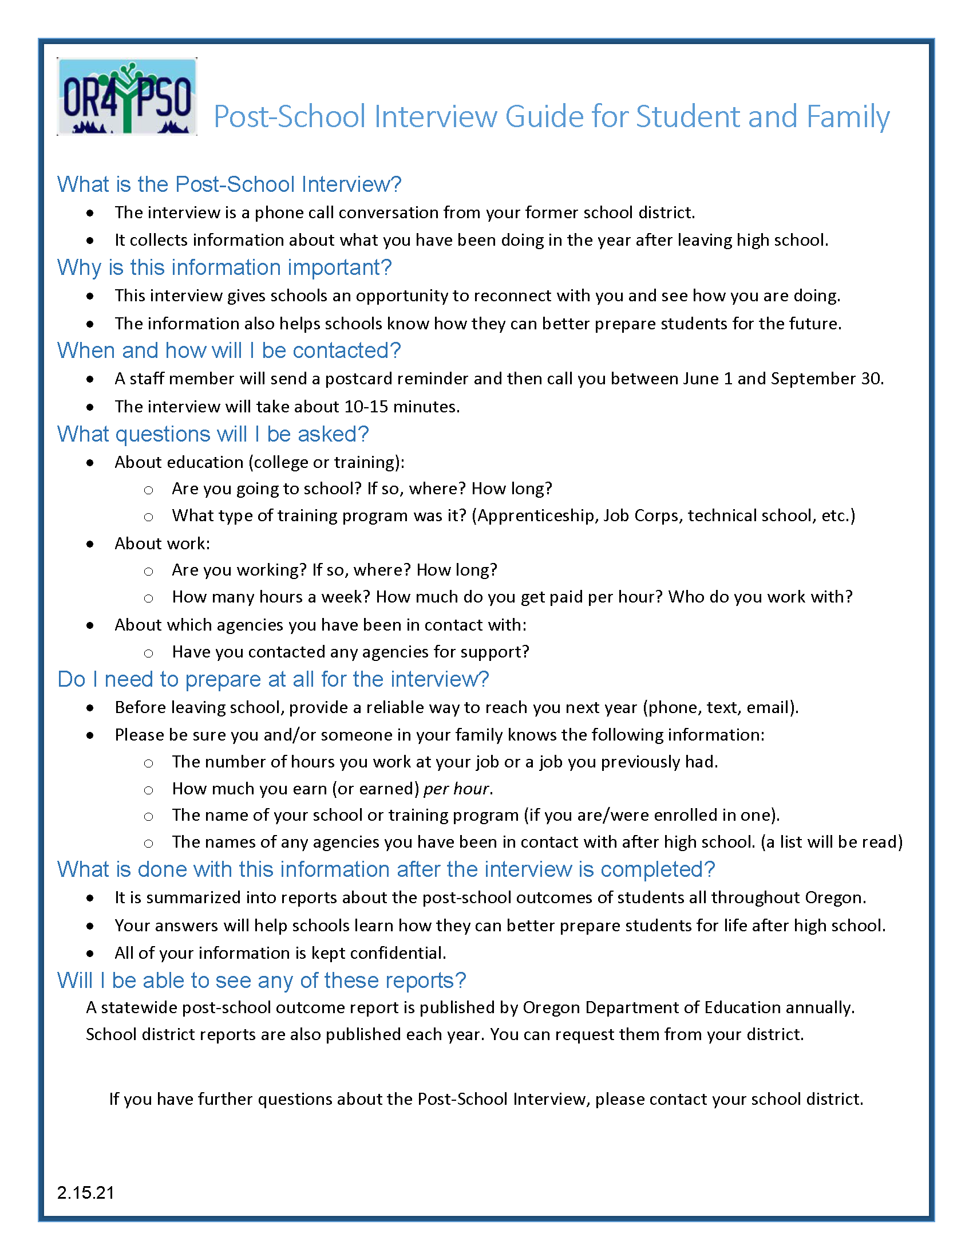
Exit Interview Resources
Resources:
Exit Interview (English, Spanish, PDF fillables)
PSO Interview Guide for Student and Family
Agreements to Participate (English/Spanish)
PSO Postcard (English/Spanish)
Found under:
PSO App 2.0 (links only) through Help/Resources:
https://district.ode.state.or.us/apps/login/
And the Oregon Transition Education website: https://transitionoregon. org/post-school-outcomes/exit-interview/
Post-School Interview Guide for Student and Family
Use as an informational handout for students/parents/ guardians when requesting the Agreement to Participate
Use during the Exit Interview, along with PSO Postcard, as an introduction to the upcoming Follow-Up Interview for the student
Distribute at IEP meeting in preparation for both the EXIT Interview and the required upcoming Follow-Up Interview one year after exit from school
29

Slide 31

The Exit Interview is a great connection!
For help or technical assistance
please contact:
pso@uoregon.edu
Charlotte Alverson calverso@uoregon.edu
Shava Feinstein
Shava.Feinstein@ode.oregon.gov
ODE DATA TEAM
ode.oss-datateam@ode.state.or.us
rev1/2024
30
Notes:
Thank you for your PSO work and support!

