Slide 1
Why Does It Matter: How to Navigate the ODE PSO 2.0 Application for the PSO Follow-Up Interview Collection
Charlotte Y. Alverson, University of Oregon
ODE-PSO Project
May 2024
4/2024rev

Slide 2
Overview
Orientation to the App
Glossary of Terms and Icons
Step-by-Step Process
Tips for Success
Assumptions:
Reviewed Part 1: Why Does It Matter
Data are being entered into the App during the interview.
This training will not address:
Conducting Exit Interviews
Reviewing Student List
Using Interview Strategies

Slide 3
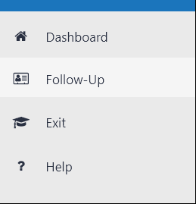
Orientation: Access & Navigation
You will access to the PSO 2.0 App from ODE via the ODE Central Login https://district.ode.state.or.us/CentralLogin
A Navigation Pane on the left side of the screen will take you directly to the:
Dashboard – also the home landing page
Follow-Up
Exit
Help
Navigate within the App by clicking buttons and or scrolling

Slide 4
Orientation
Maximize the viewing width of the screen and column categories in the PSO App by clicking either
the Menu button
the expand screen button

Slide 5
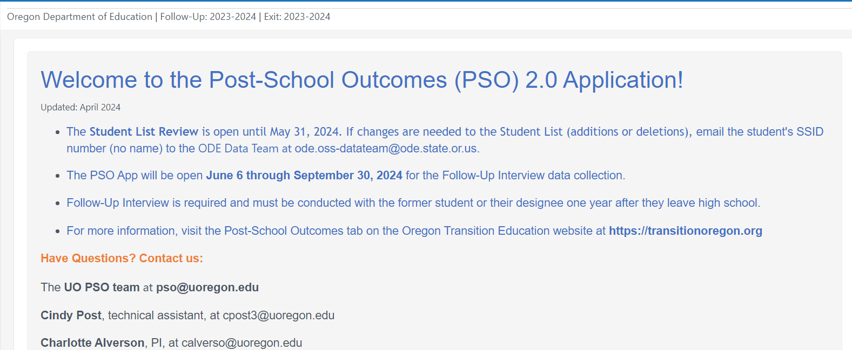
Orientation: Dashboards
Dashboards within the App highlight key information
ode.oss-datateam@ode.oregon.gov

Slide 6
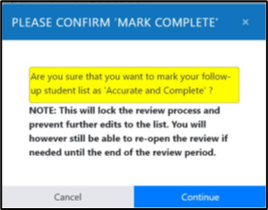
Orientation: Buttons and Pop-Ups
Buttons are used to navigate through the App
Pop-Ups provide information and feedback
The mouse pointer becomes a finger icon on active buttons

Slide 7
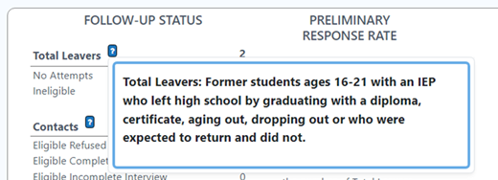
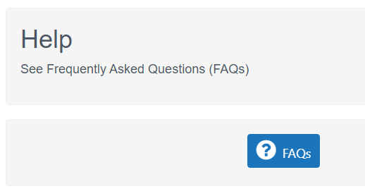
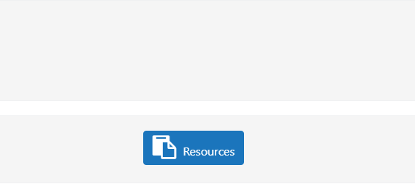
Orientation: Help
Click the Help icon with a question mark to open a pop-up box with information
Click ? Help in the Navigation pane to go to a Frequently Asked Questions (FAQs) document and list of Resources

Slide 8
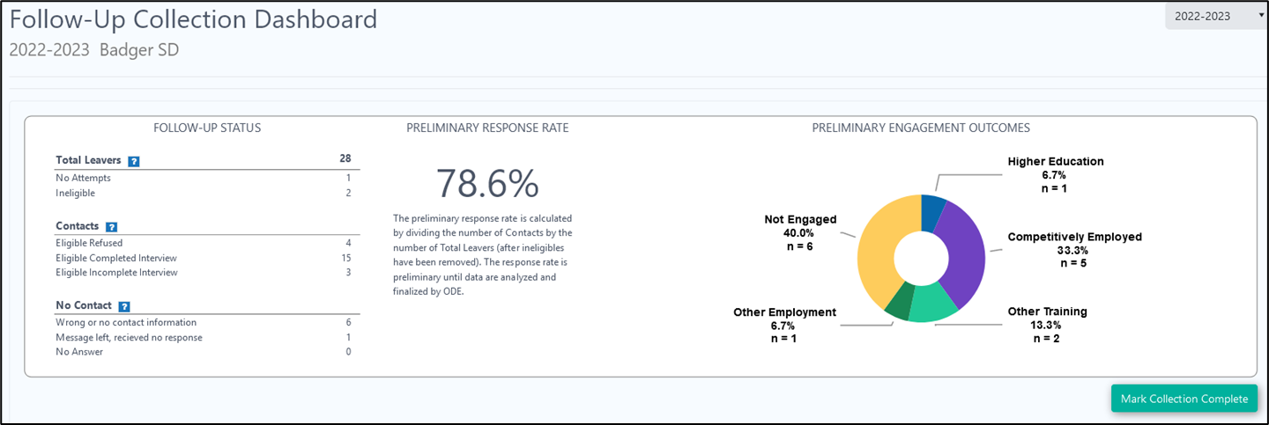
Orientation: Progress
As data are collected in the App, progress is shown on the Follow-Up Collection Dashboard.

Slide 9
Access to the PSO 2.0 Application

Slide 10
Step 1: Access to the PSO 2.0 App
Get permission from your special education director to obtain a password for access
Login to Central Login site at https://district.ode.state.or.us/CentralLogin/
If needed, locate your District Security Administrator for access to the application
Select Special Ed Post School Outcomes 2.0 – Oregon Department of Education
9
Notes:
Same access as for Exit Interview

Slide 11
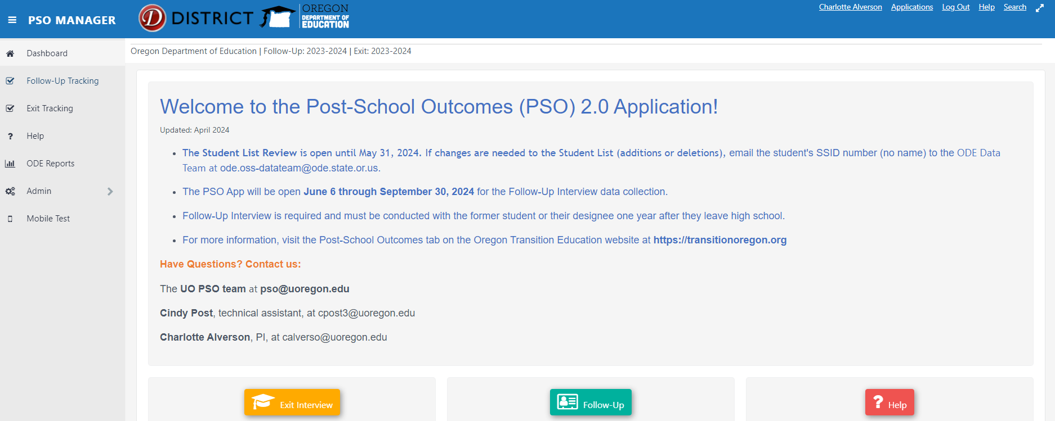
Step 1: Welcome to the Post-School Outcomes (PSO) 2.0 Application
Land on the Home Dashboard

Slide 12
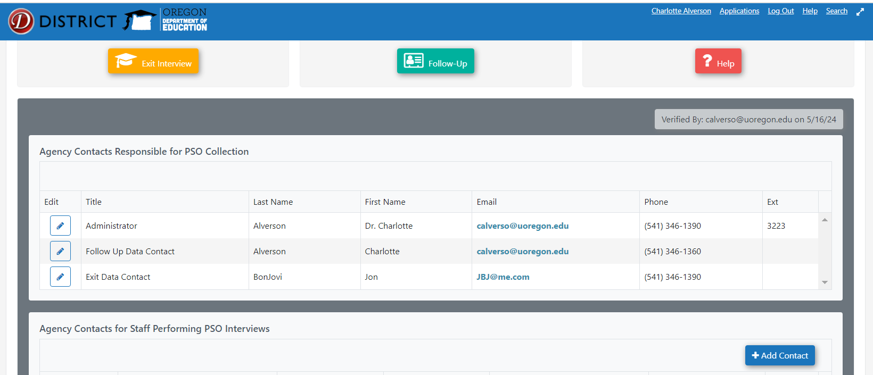
Step 2: Update Agency Contacts
Scroll past the Dashboard to Agency Contacts Responsible for PSO Collection and Agency Contacts for Staff Performing PSO Interviews
This information must be provided to continue to the interview

Slide 13
Step 2: Update Agency Contacts
Under Agency Contacts Responsible for PSO Collection
Click the Edit button to change the title, name, email, and phone number for the Administrator, Follow-Up Data Contact, and Exit Data Contact.
Under Agency Contacts for Staff Performing PSO Interviews
Click the Edit or Delete button to update the contact information for staff conducting the interviews.
Click Add Contact button to add new data collectors.
List all data collectors. There is no limit to the number of people listed here.
Click the button Click to Verify if the information is still correct or revisions were made.

Slide 14
Step 3: Enter “Follow-Up” within the App
After updating Agency Contacts and Interviewers,
Click the Follow-Up button to enter your district/school site

Slide 15
Step 3: Enter “Follow-Up” within the App
The Follow-Up button takes you to the Follow-Up Dashboard
Make sure the correct school year (2023-2024) is selected from the dropdown

Slide 16
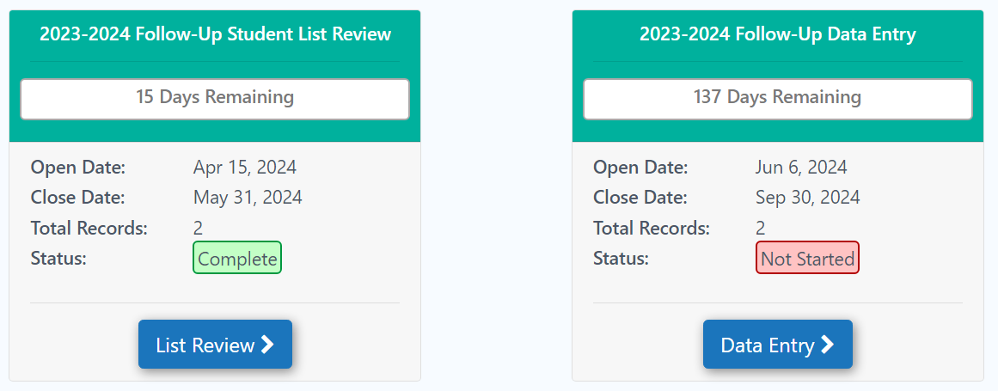
Step 4: Data Collection and Entry
Scroll past the Follow-Up Dashboard for the district listings
Click on the Data Entry button to begin an interview
My SD 411
31

Slide 17
Step 4: Data Collection Follow-Up Collection Dashboard
The Data Entry button takes you to the Follow-Up Collection Dashboard
The Follow-Up Collection Dashboard shows the Status of the data collection, the Preliminary Response Rate, and Preliminary Engagement Outcomes.
This information is dynamic throughout data collection. It is preliminary until ODE verifies these data.
32

Slide 18
Step 4: Data Collection Follow-Up Collection Dashboard
Scroll past the Dashboard to see the school or list of schools in the District
Some schools may have an asterisk by the name
The asterisk indicates a special program attended by one or more students from the district.
The asterisk will also be listed by the student’s name.
32
Notes:
You may be interviewing students from multiple schools. Click the name of the school to see a list of students.

Slide 19
Step 4: Data Collection Special Programs
The Special Program is the attending school.
The student’s home district is the resident district.
The resident district is responsible for PSO Follow-Up Interview
Best practice is to coordinate with the attending district to do the Follow-Up Interview with the former student or their family designee.
The attending school has the relationship with the former student/family
Please be patient; there is no list of all special programs.
Notes:
Some students may attend a school or program outside of their resident district; this is called a Special Program.
The special program is considered as the Attending District. The collection of the Follow-Up interview is required of the Resident District. Some examples of Oregon Special Programs are: Local ESDs, Wellsprings, Levi Anderson, Serendipity, Riverfront, Oregon School for the Deaf, Bridgeway House, Westmoreland.

Slide 20
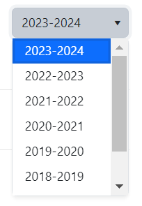
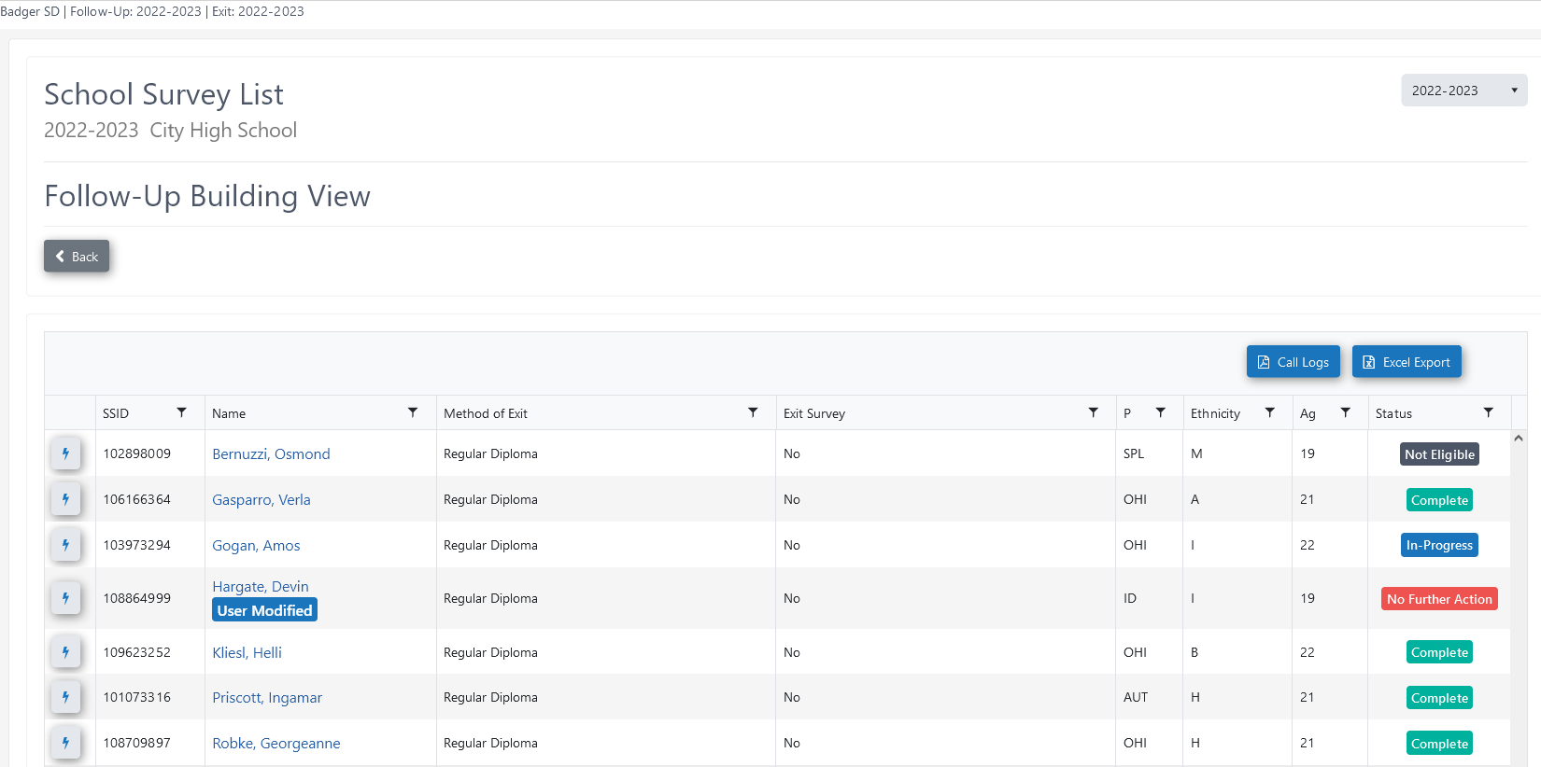
Step 4: Data Collection Follow-Up Collection Dashboard
Click on the name of the school to see a list of students
Make sure the current school year shows in the dropdown
Confirm student information - Name, Method of Exit, Exit Survey, Primary Disability, Ethnicity, & Age
32
Notes:
You may be interviewing students from multiple schools.
Click the name of the school to see a list of students.

Slide 21
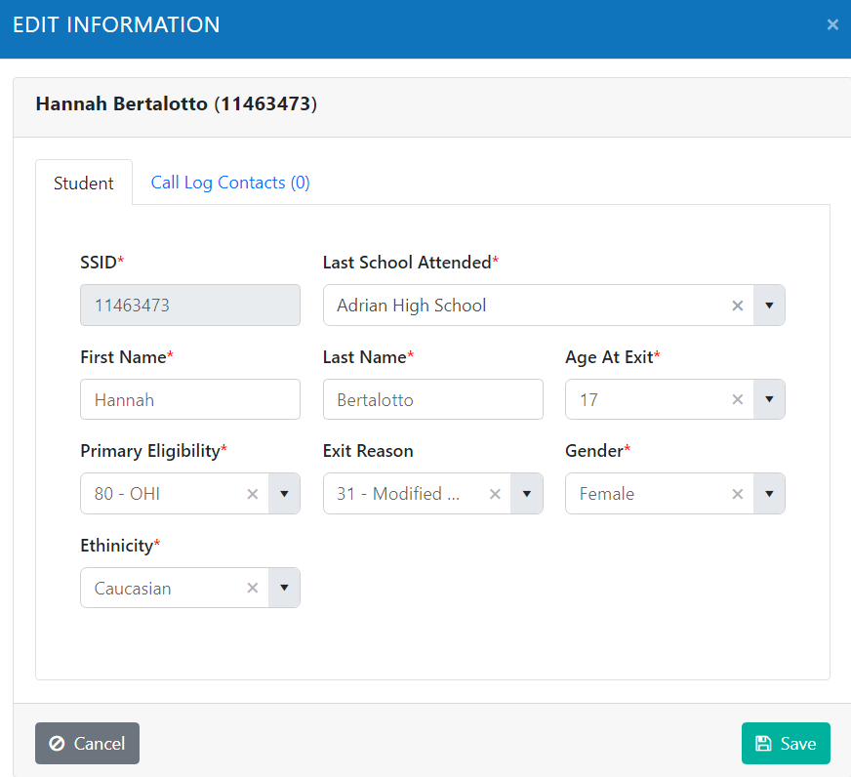
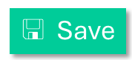
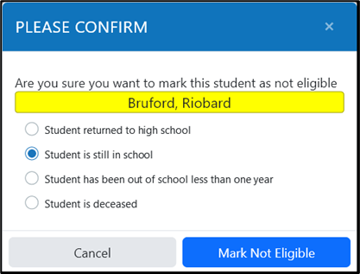
Step 4: Data Collection Edit Student Information
Click the Lightning Bolt button to
Edit the last school attended, or
Mark the student as ineligible.
Click the Save button if editing last school; only ODE Data Team can make other edits
If marking student ineligible, confirm the reason the student is ineligible
Returned to high school
Still in high school
Has been out of school for less than one year
Student is deceased
Hannah Banah (111111111)
111111111
Mudd High School
Banah
60 - ED
31 – Regular Diploma
Banah, Hannah

Slide 22
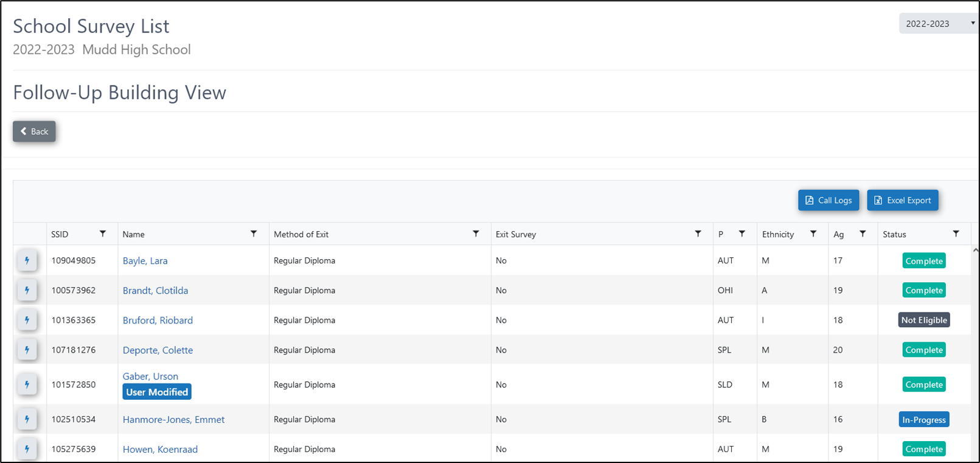
Step 4: Data Collection The Interview
Click on the student’s name to start their interview

Slide 23
Step 4: Data Collection Contact Information
Contact information entered in the Exit Interview is carried forward to the Follow-Up Interview
When no contact information is listed, use district or other resources to find contact information
Notes:
Clicking the student’s name takes you to the student’s interview. You’ll see any contact information carried forward from the Exit Interview

Slide 24
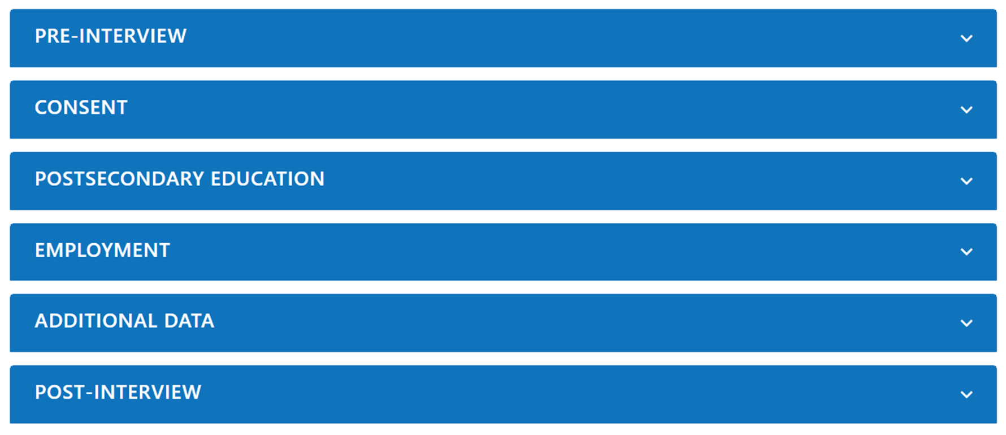
Step 5: Follow-Up Interview
Six Areas of the Follow-Up Interview

Slide 25
Step 5: Follow-Up Interview
Pre-Interview – the interviewer confirms student is eligible for the Interview by answering “Yes” or “No”
Is this student eligible to take the Follow-Up Interview?
A “No” response (meaning ineligible) requires the reason a student is ineligible
Consent – determines whether the former student or family designee is willing to answer questions.
“Are you (student, family, or other contact) willing to answer a few questions about your education, jobs, and life in general following High School?”
The former student or their family designee answers “Yes” or “No” to this question
Only the former student or family designee can answer this question
Interviewer does not answer this question on behalf of the former student
A refusal (saying no) is a valid response to this question
Not having contact information or not getting an answer after leaving a message is not a refusal because you did not talk to a person
Notes:
You cannot have a “NO” answer on consent and state in the post-interview that you did not speak to anyone.
If you have No Contact, this answer cannot be a “No”

Slide 26
Step 5: Follow-Up Interview
Postsecondary Education – Maximum 3 questions – to determine whether the former student enrolled in further education since leaving high school.
Employment – Maximum 8 questions – to determine whether the former student enrolled worked since leaving high school.
Additional Information – 11 questions – supplemental questions about the former student’s experiences
Post-Interview – 5 questions about who and how data were collected

Slide 27
Step 5: Follow-Up Interview
An attempt is logged in the system each time a student’s name is clicked.
Each attempt results in one of three outcomes:
Talked to a person
Contact – Survey Complete OR refused
Contact – Survey interrupted – Will Complete Later
Did not talk to a person
No contact – Will not complete an interview
No contact – Will complete an interview later

Slide 28
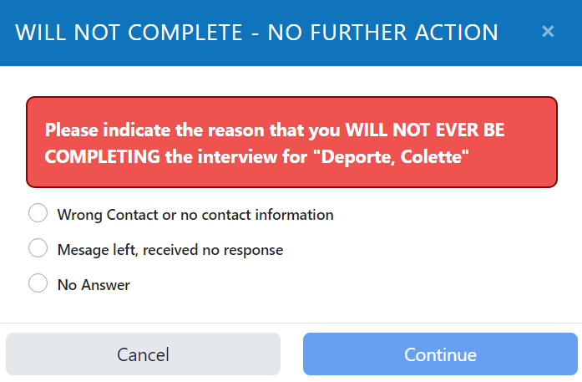
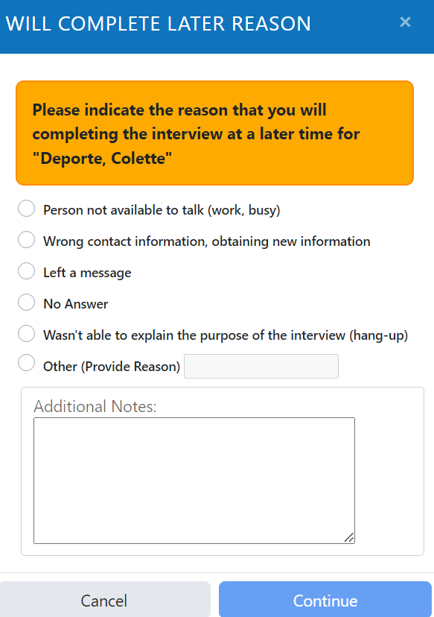
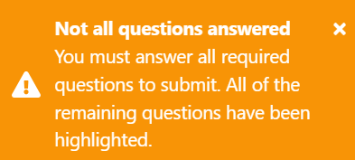
Submit Buttons
MUST HAVE TALKED WITH A PERSON
Notes:
Will Not Complete means the interviewer will take no further action to reach the former student/designee. Select the reason for no further action from the list – wrong contact information; message was left, received no response, or no answer – (rang, could not leave a message). Leave explanatory notes in the Interviewer Notes/Comments.
Will Complete Later (Still In Progress) means the interviewer will continue trying to reach the former student/designee. Leave Additional note here for other interviewers, note to self, record new phone number, etc.

Slide 29
Step 5: Follow-Up Interview Decision Tree
Attempt an Interview
Talked with a person
Did not talk with a person
Explained purpose of the call and person agreed to answer questions (consented).
Explained purpose of the call and person did not agree to answer questions (refused).
Will try again.
Will not try again.
Enter a note/comment in the Post-Interview.
Select “Will complete later.”
Try another day, time, or contact method.
Complete the Post-Interview.
Select “Will Not Complete.”
Select reason for not completing and explain anything unusual in Interviewer Notes.
Do not select ‘Submit’
Select Yes on Consent.
Continue with the interview.
Complete Post-Interview
Select ‘Submit’
End the interview.
Select ‘No’ on Consent.
Complete Post-Interview.
Select ‘Submit”
Notes:
A decision tree for attempting an interview
Did not talk to a person – either you (a) will try again to reach the former student, or (b) will not try again to reach the former student or their designee.
@Post – Interview
scroll to “Notes/Comments” and enter any relevant note, e.g., “call after 10 am”
Select Will Complete Later
Select Reason for completing later and enter any relevant note “mom gave new cell number”; “sent text asked her to call me” – all interviewers can see this note

Slide 30
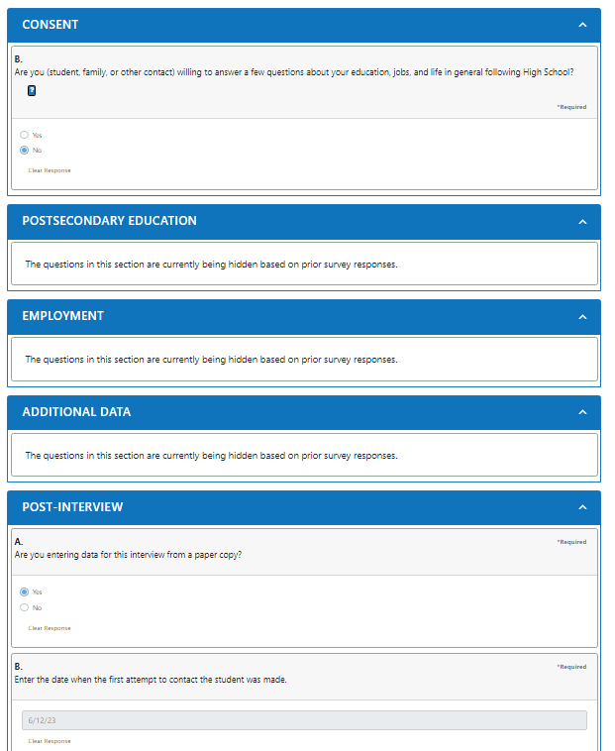
Step 5: Follow-Up Interview Consent
Use the Follow-Up Telephone Survey Script
A person must answer this question.
When “No” is answered to the Consent question, only the Post-Interview section is accessible; no other sections of the interview are accessible.
The Post-Interview questions are required.
The system has built-in skip logic to ensure the correct questions are asked.
If no one is reached, try another way/day.

Slide 31
Step 5: Follow-Up Interview Asking Questions
Be conversational with the interview
Read the question as written
Rephrase or explain only to help someone who cannot understand the question as written
Probe – used to clarify respondents’ answer or obtain more information when the answer was incomplete, irrelevant, imprecise/evasive
Do not read the list of response options to the respondent
Be familiar with the interview protocol

Slide 32
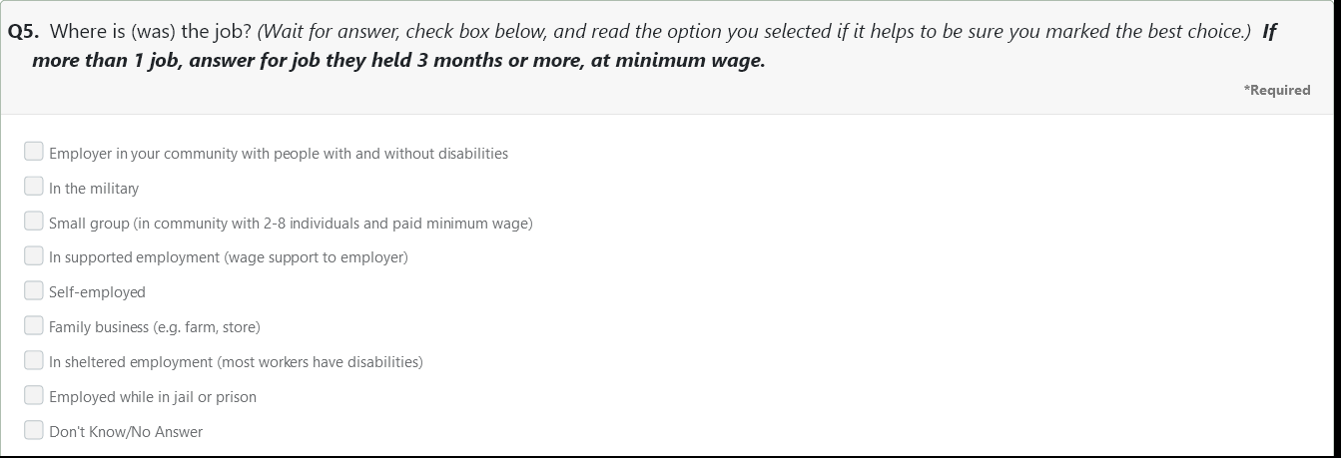
Step 5: Employment Questions Location of the Job
Ask the question, listen for the answer; avoid reading the list of response options
Small group means a group of individuals with disabilities working together under the supervision of an agency employee in a community business or industry

Slide 33
Step 5: Employment Questions Minimum Wage
Minimum wage is a required question.
Oregon’s minimum wages are available in the dropdown list.
For Oregon cities, ask: “Are you making at least $ ___ [read amount from dropdown menu] per hour?”

Slide 34
Step 5: Employment Questions Minimum Wage
Select OTHER if the city/town is not listed or is outside of Oregon.
Enter the City/town where the student is working.
Ask “Are you making at least minimum wage?”

Slide 35
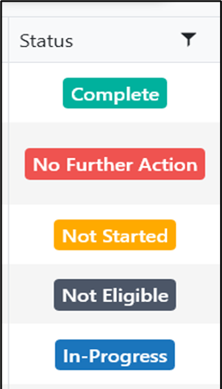
Step 5: Follow-Up Interview Status Progress
Status is visible for each student’s interview
Answering Question 1 in Postsecondary Education puts the interview “In Progress”
Complete – Interview is done (answered all questions or refused)
No Further Action – No contact will be made for specific reason; must report a reason
Not Started – Question 1 in Postsecondary Education has not been answered
Not Eligible – Student marked as ineligible; must report the reason
In Progress – At least Question 1 has been answered; will remain “In Progress” until “Submit”, or “Will Not Complete” button is clicked

Slide 36
Step 6: Complete or Incomplete Interview
A completed interview means either
Answered all the questions
OR
Refused to participate

Slide 37
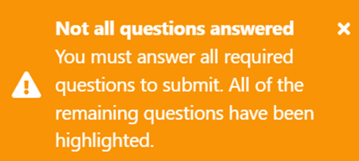
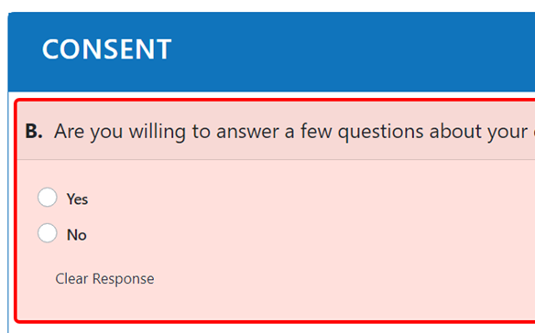
Step 6: Complete or Incomplete Interview
When you click the Submit button, you’ll see one of two messages:
Survey Submitted or Not all questions answered
If the Consent question is highlighted, and you did not talk to a person,
Click the Will Not Complete button. Consent requires you to talk to a person.
Must talk to a person to answer this question.

Slide 38
Step 6: Complete or Incomplete Interview
An incomplete interview means either
Did not reach a person to conduct the interview and you will try another day, time, or contact method.
Some questions were not answered (e.g., interview interrupted)
Select the Will Complete Later button

Slide 39
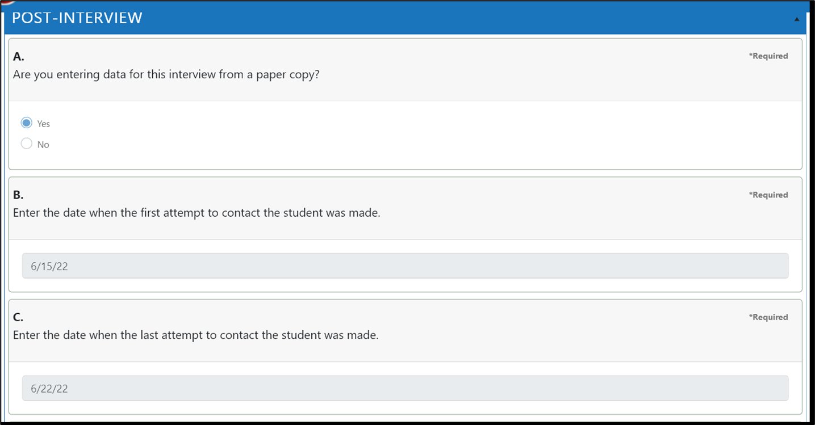
Step 7: Post-Interview Questions
Post-Interview section is required for ALL interviews, including those that were refused or Will Not Complete.
Additional questions are asked if data are entered from a paper copy of the interview
Notes:
Paper copy Y/N
First attempt date
Last attempt date
Total # of attempts
Name of person entering data
Position of person entering data

Slide 40
Step 7: Post-Interview Questions
Use the Interviewer Notes to describe unusual events, critical information, or challenges with an interview
Notes:
Paper copy Y/N
First attempt date
Last attempt date
Total # of attempts
Name of person entering data
Position of person entering data

Slide 41
Step 8: Submit the Collection
When all the interviews are complete, or on September 30, whichever comes first,
Click the Mark Collection Complete button on the Follow-Up Collection Dashboard

Slide 42
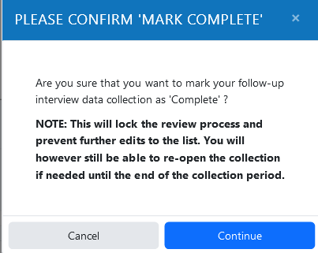
Step 9: Mark the Collection Complete
You will be prompted to confirm the collection is complete.
Click the Continue button on the
pop-up to close the collection.
Click the Unlock Collection button to edit data collection prior to September 30. After September 30, the App cannot be reopened.
Your collection is currently marked ‘Complete’. If you need to
make further changes, click the ‘Unlock Collection’ button.
54
Notes:
After full review of completed input or at end of September, whichever comes first, finalize input with the submission button, Mark Collection Complete
(NOTE: you may want to verify this with your Director of Special Education/Student Services before clicking the button for the final submission.)

Slide 43
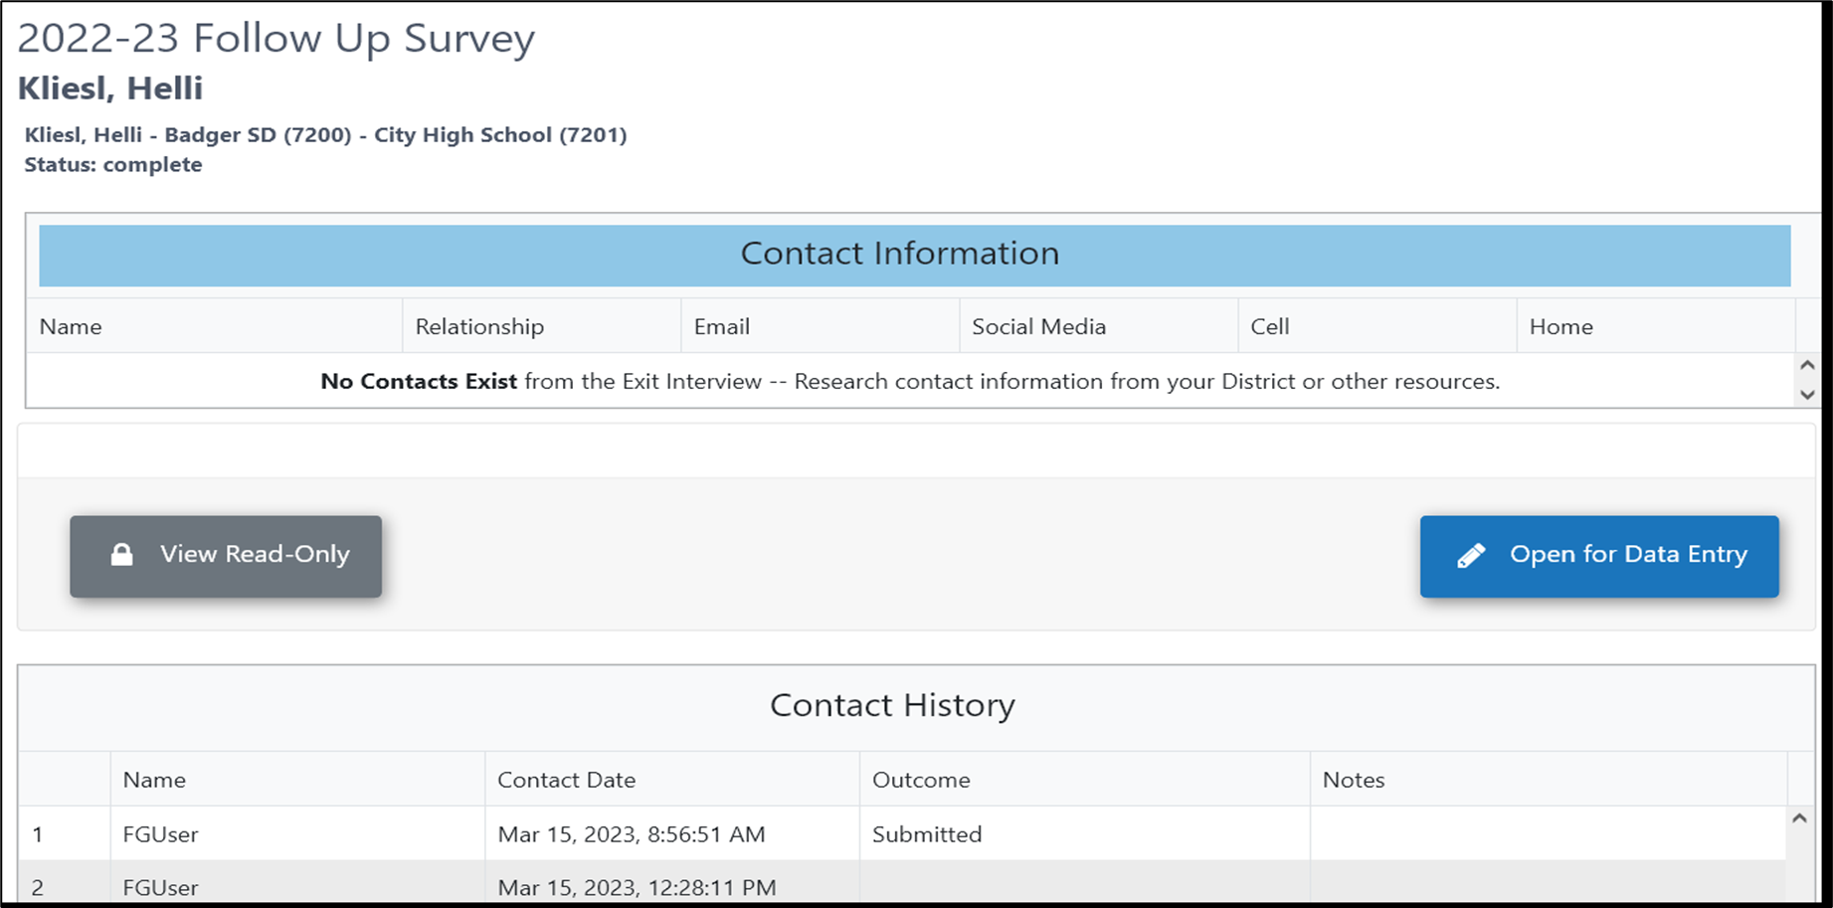
Step 10: Follow-Up Interview Re-Open a Completed Interview
The PSO system automatically records date and time each record is opened for an interview.
Click Open for Data Entry to re-open an interview after it has been submitted.
Notes:
Each time you click “Open for Data Entry” an attempt is recorded and you will have to add the outcome reason and notes

Slide 44
Step 9: Mark the Collection Complete
Click the “Mark Collection Complete” button when all interviews have been done, or on September 30th, whichever comes first.
54
Notes:
After full review of completed input or at end of September, whichever comes first, finalize input with the submission button, Mark Collection Complete
(NOTE: you may want to verify this with your Director of Special Education/Student Services before clicking the button for the final submission.)

Slide 45
Tips

Slide 46
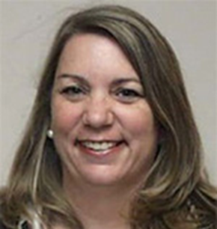
Tip 1: Reach Out with Questions
Contact the UO PSO Team for help
Attend the Open Mic Question and Answer Sessions
May 30 @ 3:00 – register at https://transitionoregon.org/event/open-mic-question-answer/
August 29 @3:00 – register at https://transitionoregon.org/event/open-mic-question-answer/
Charlotte Alverson
calverso@uoregon.edu
Cindy Post
cpost3@uoregon.edu
pso@uoregon.edu

Slide 47
Tip 2: Use the Website
Check the website, https://transitionoregon.org/post-school-outcomes/ for current resources and forms.

Slide 48
Tip 3: Use the Resources
Video Recordings and transcripts from previous trainings
Ready, Set, Go for PSO: What veteran data collectors need to know for 2024
The Results Are In: Post-School Outcomes for Students who Left School in 2021-2022
One-Page PDF Resources
Accessing the ODE Post-School Outcomes (PSO) Application 2.0 for the Follow-Up
The 5 W’s to Understanding the Post-School Outcomes (PSO) Data Collection
Follow-Up Telephone Survey Script
Contacting Hard-to-Find Youth: Strategies for the Post-School Survey
District Post-School Outcomes (PSO) Timeline

Slide 49
Tip 4: Become Familiar with the Interview
Be familiar with the interview
Purpose of the Follow-Up Interview
“To learn what you have been doing since you left high school.”
How the information will be used
“This information helps us make school better for other students like you.”
Questions asked and instructions for asking the questions
All information is confidential
Be prepared to answer the respondents’ questions
Why are you calling me?

Slide 50
Tip 5: Become Familiar with the App
Use the Navigation Pane
Maximize the increase viewing width of the screen and column categories in the PSO App by clicking either
the Menu button or
the expand screen

Slide 51
Tip 6: Leave Comments in the App
Comments are important and helpful.
Comments left when “Will Complete Later (Still In Progress)” is select show in Notes of the Contact History
When “Will Not Complete (No Further Action)” is selected, leave notes in the Interviewer Notes
Notes:
The Contact History shows each time an interview was opened for a former student. It automatically records each attempted contact. When “Will Complete Later” is selected, the note shows in the Note section of the Contact History. In this way, Interviewers can leave a note for themselves or another interviewer or an administrator. Anyone attempting to reach the former student will see these notes.
When Will Not Complete is selected, leave any note in the Interviewer Note/Comment question of the Post-Interview section of the interview protocol.

Slide 52
Reminders
Your support of this data collection is important and appreciated
State goals: 100% attempt; 85% completed interviews; and 76% total engagement
PSO Follow-Up Interview data collection is required
PSO 2.0 App is open for data collection between the first Thursday in June and last Friday or Monday in September
Data collection can begin when the student has been out of school for at least 365 days
Review the Student List and confirm it is accurate & complete.
Contact the ODE Data Team to make changes to the Student List
Practice the Telephone script
Use the App – it’s easier, more secure, eliminates duplicated efforts
UO PSO Team is here to help – ask questions
30
Notes:
Be Prepared
List of students reviewed and confirmed as complete
Review and get to know the interview
Contact list available and handy
Template for local Community Resources can be found on the ODE Telephone Script document that is listed in Help/Resources under Follow-Up with a link to the document on Transition Oregon website: transitionoregon.org

Slide 53
Questions
60

Slide 54
Thank you! Be in Touch with Us
Shava Feinstein
Shava.Feinstein@ode.oregon.gov
Charlotte Alverson
calverso@uoregon.edu
Cindy Post
cpost3@uoregon.edu
ODE Data Team email:
ode.oss-datateam@ode.oregon.gov
UO Support email: pso@uoregon.edu
5/2024 rev.
61

