Slide 1
Unlocking the Power of PSO Data: Enhancing Skills and Insights
Shava Feinstein, ODE and Charlotte Alverson, UO
Oregon Statewide Transition Conference
Tennessee Williams Room
March 14, 2024 11:15 – 12:30
Notes:
Intro : Shava
Questions: how many of you have conducted PSO interviews ?

Slide 2
What are Post School Outcomes? Indicator B-14
B-1: Graduation Rates
B-2: Dropout Rates
B-13 Quality Transition IEP Indicator
B-14: Participation in Post Secondary Settings
Notes:
Indicators are measurements of compliance
Measures how well the state is implementing IDEA.
Of the 17 IDEA Part B indicators, only 4 relate to secondary transition:
INDICATOR B1: GRADUATION RATES: Percent of youth with IEPs exiting special education due to graduating with a regular high school diploma
INDICATOR B2: DROPOUT RATES: Percent of youth with IEPs who exited special education due to dropping out
INDICATOR B13: POSTSCHOOL TRANSITION GOALS IN IEP: Percent of youth with IEPs aged 16 and above with an IEP that includes appropriate measurable postsecondary goals, annually updated and based upon an age appropriate transition assessment,
transition services, including courses of study,
that will reasonably enable the student to meet
those postsecondary goals, and annual IEP goals
related to the student’s transition services needs.
INDICATOR B14: PARTICIPATION IN POSTSECONDARY SETTINGS: States must report percent of youth who are no longer in secondary school, had Individualized Education Programs (IEPs) in effect at the time they left school, and were in: 14A. higher education 14B. higher education or competitively employed 14C. higher education or in some other postsecondary education or training program; or competitively employed or in some other employment within one year of leaving high school.

Slide 3
Indicator B-14
Engaged
Higher education
Not Engaged
Competitive employment
Other post-secondary education/training
Some other employment
Students are not meeting any engagement category
States must report the Post School Outcomes (PSO) which is the percent of youth who are no longer in secondary school, have IEP in effect at the time they left school.

Slide 4
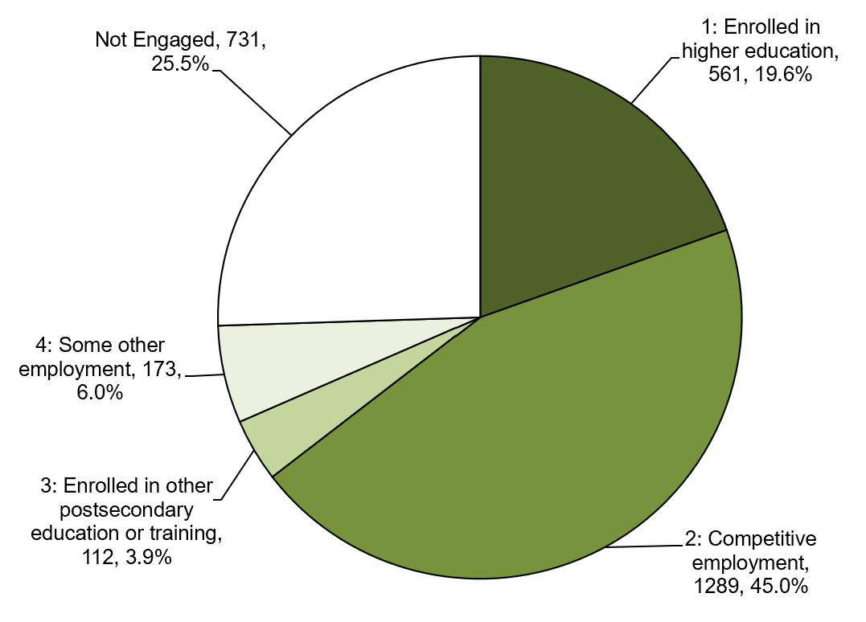
Oregon’s PSO Results for School Year 21-22
Total Former Student Leavers
5,435
Total Respondents
2,866 (52.7%)
Total Engaged
2,135 (74.5%)
Not Engaged
731 (25.5%)
Notes:
Year Total Leavers Total Respondents Total Engaged Not Engaged
FFY20 4847 2775 2001 (72%) 774
FFY21 4601 2782 2100 (75.5%) 682
FFY22 5435 2866 2135 (74.5%) 734

Slide 5
Indicator B-14 Data Post School Outcomes Interviews
Follow-Up Interview
Conduct the required interviews by contacting former students who were receiving Special Education Services one year beyond exit from high school
Can be completed anytime during the school year in which the student will exit or graduate
Exit Interview
Notes:
How do states collect the data for this reporting requirement

Slide 6
PSO Exit Interview
Make a final connection with the student
Assist students with future plans and resources
Obtain contact information necessary to perform the mandated Follow-Up Interview one year beyond student exit
(Details related to exit interviews)
Notes:
To gather PSO data from all former students who were receiving special education services at the time they exited high school, school districts conduct a phone survey each year during a specific time frame

Slide 7
PSO Follow Up Interview
Follow Up Interviews are conducted via phone by school district personnel.
PSO Data is used to provide both state and district-level reports.
Districts and states use data to help inform program change for future students.
(Details related to exit interviews)
Notes:
Ask participants how many are using paper copies for phone interviews.

Slide 8
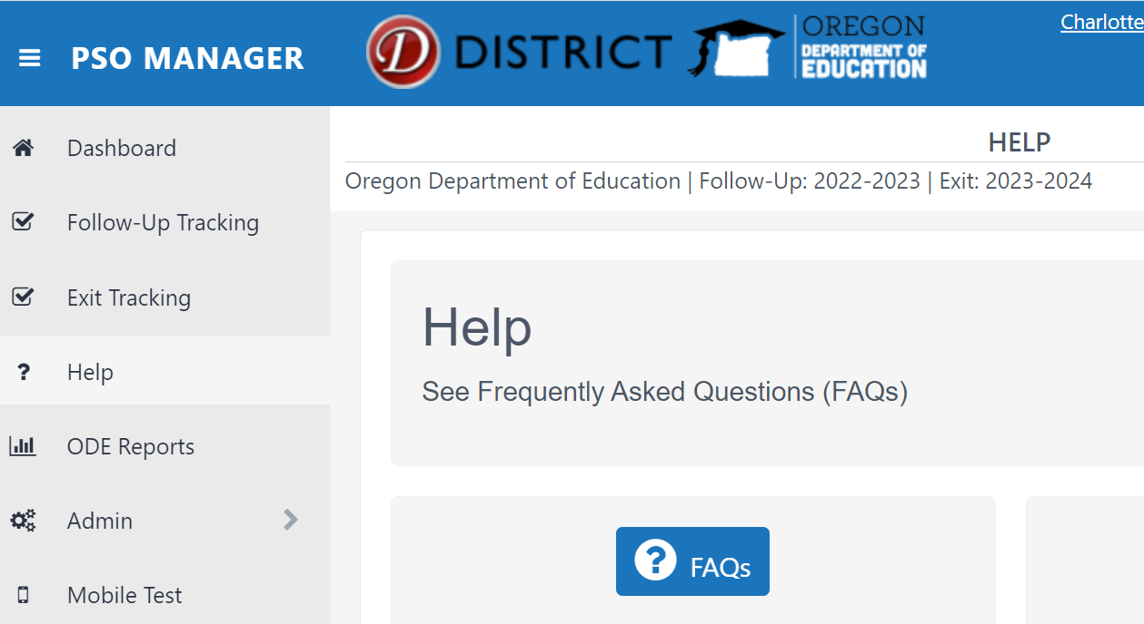
Resources
In the App
On the web
Click HELP on the navigation bar to access FAQs and a resource list
Click Post-School Outcomes on the website: transitionoregon.org
Notes:
https://transitionoregon.org/transition-handbook/

Slide 9
PSO Follow Up Year Interview Data Collection Process
Data collection process
Collect multiple contacts (phone, email, postal mail address)
Notify former students and families
Prepare for the Follow-Up Interview (attend trainings, review materials)
Interview former students or their designeee
Ensure data are accurately entered into the PSO 2.0 App
(Details related to exit interviews)
Notes:
Shava : Ends here

Slide 10
Definitions
Interview: An interview is a conversation with a purpose.
Purpose of the PSO Interviews: Is to learn what former students are doing after high school - working or going to school
The progress of the interview requires skills and capability of the interviewer
Interviewer: The interviewer is the person tasked to complete the interview according to the procedures outlined.
Pose the questions on the questionnaire, listen to and record the answers of the interviewees

Slide 11
Role of the Interviewer
Being an interviewer…
is a major responsibility
is one of the most important roles on the project
Interviewer is responsible for collecting the information in a accurate, reliable, and appropriate way.
Success of the project is dependent to a great degree on the interviewer’s conscientiousness, effort, and cooperation.
Notes:
Interviewers are critical; they provide the data on which the state’s post-school outcomes reports are based.
If interviewers do not gather data in an accurate and uniform manner, the results may be inaccurate and misleading, and could lead to erroneous conclusions regarding the post-school outcomes of former students.
Ethical responsibility to ensure each interview is
Voluntary
Confidential
Accurate

Slide 12
Responsibilities of the Interviewer
Preparing for the interview
Attending and actively participating in trainings.
Asking questions
Making sure you can log-in
Reading through the materials (questionnaire, directions)
Conducting the interview
Ensuring the person is eligible to be interviewed
Ensuring the person understand the purpose of the interview and the questions
Allowing sufficient time to complete the survey without rushing
Allowing time for responses when messages are left
Completing the interview
Correctly following the questionnaire directions
Accurately recording the information
Filling in all the information required on the form, including interviewer notes.
Finishing the interview
Reviewing each questionnaire to ensure that all questions were asked and data were recorded, including interviewer notes

Slide 13
As interviewers, what you do is important!

Slide 14
Accuracy
Consistent survey administration by each interviewer for each interview
Accuracy is influenced by
The way you and the respondent understand the purpose of the survey.
What you and respondents believe are the correct answers to the questions.
The ability of the respondent to understand the questions and your ability to understand their responses.
The honesty of everyone involved.

Slide 15
Would you prefer to talk with a teacher or a professional interviewer?
Majority of the youth preferred to talk with a former teacher
“Yeah, I would talk to a teacher because I know them”; and “I know their names” (MN Males)
Only a couple of students preferred to talk with a professional interviewer
“…it’s easier to say things to interviewers that you think you’ll never see again. That it will remain confidential. You can say more things, there’s less restrictions on who or what is being talked about because no one will be offended” (TN Male)

Slide 16
Interviewer Materials
Questionnaire – to become familiar with the questions and answer options; to practice asking and answering questions
Phone Script – to introduce the purpose of the interview
PSO Post-Card – to remind or inform former students that they will be called
All of these materials (and more) are on the website
Transitionoregon.org

Slide 17
Voluntary
Informed consent – Agreement to Participate
Is not required for Follow-Up Interview
Consent is given by answering questions
They can refuse to participate or refuse to answer any question
Must talk to someone to record a “refusal”
Be prepared to
communicate the importance of the interview
“The information you share will help other students like you/your child.”
answer questions from respondents, “Do I have to do this?”
It is up to you to participate in the survey. You can refuse to answer any question. I will not share the information you give me with anyone. Your answers will be combined with a bunch of others’ answers and used to help other students like you/your child.

Slide 18
Confidentiality
Information is not shared with anyone else
All paper and electronic information containing personally identifiable information must not be available to anyone outside of the survey team. Keep survey materials locked in a private place; logout of the App
All information obtained during student interviews must be kept confidential by the district and interviewers
Avoid discussing who you interviewed and what they said, even with co-workers who know a respondent

Slide 19
Resources
In the App
On the web
Click HELP on the navigation bar to access FAQs and a resource list
Click Post-School Outcomes on the website: transitionoregon.org

Slide 20
PSO Response from the Field: What strategies do you use when contacting former students?
“Multiple strategies! We start with asking Teachers to work with their students before they graduate/leave, to fill out "Student Information Forms”...
“We ask the students to think ahead to the following year - to provide the information that will be accurate for the following summer……This provided information tends to be NEWER and more accurate than what is available in the Student Information System database (Synergy)”.

Slide 21
Making the Calls
Between 9 a.m. and 9 p.m. – be mindful of holidays, mealtimes, special events
Multiple Attempts on Multiple Days at Multiple Times
Vary the times: weekdays, evenings 5:30 – 9:00, and weekends
Be persistent and creative
Introducing the Interview
Giving respondents the information they need to make an informed decision about whether to participate
Who you are, why you’re calling, how the information will be used
Notes:
Introduction is a Critical Step
Tells them that the survey is voluntary; they can refuse to answer any question.
Assures them the information is important to their school district and the state.
Assures them that what they say is protected and will be kept private and confidential.
Who you are
Explains that their name won’t appear in any report and that their responses will be combined with many other surveys.
Notifies them that they can have someone help them answer any part or all of the survey.

Slide 22
PSO Response from the Field: What strategies do you use when contacting former students?
“It's really important to collect Exit Interview Data so that you have contact information.”
“Our … Special Education Administrative Assistant …… began making phone calls in June and she and I made a couple of home visits to complete some of the interviews for families we were unable to reach by phone. When she returned in August, she started working on this again until all interviews had been completed. I believe close relationships and continual contact with families while students are in school increases the likelihood of participation post graduation.” Betsy - Special Education Coordinator

Slide 23
Be Prepared to Respond to Questions
Respondents often have questions before they agree to the answer any survey questions.
Taking the time to answer these questions will facilitate completing interviews
Notes:
Question wording and order are important
Read the question as written
Rephrase or explain only to help someone who cannot understand the question as written
Probe – used to clarify respondents’ answer or obtain more information when the answer was incomplete, irrelevant, imprecise/evasive

Slide 24
Frequently Asked Questions
What is the purpose of this interview?
How will these data be used?
How did you get my telephone number?
How was I chosen for this survey?
Who is sponsoring (paying for) this study?
How long will the interview take?
Is this interview confidential/anonymous?
What if I do not want to answer a question?
Why are you calling me. You can’t call me because … I signed up for the ‘Do Not Call’.

Slide 25
Asking the Interview Questions
Question wording and order are important
Read the question as written
Rephrase or explain only to help someone who cannot understand the question as written
Probe – used to clarify respondents’ answer or obtain more information when the answer was incomplete, irrelevant, imprecise/evasive

Slide 26
Question Probes
Probes are used to solicit additional information from respondents or clarify an answer
Neutral, not leading, open-ended
Wait- silence; allow time to process the question and think of the answer
“Tell me more about that.”
“What do you mean?”
“Tell me about it.”
“Can you be a little more specific?”
“I’m not sure I am entirely clear about what you mean. Could you explain it a little more?”
“Could I read back what I have written to be sure I have understood exactly what you wanted to say?”
“Could I reread the question and the answer I’ve written down just to be sure I have gotten everything you wanted to say?”
“I think I may not have read the question correctly, so may I read it to you again to be sure?”
Notes:
Have you worked for at least 90 days – “well, I work sometimes”.
Wait
Tell me more about that or what do you mean.

Slide 27
Respondent Sources
Student – Primary Source
Family – Secondary Source
Other – Tertiary Source
Notes:
I want to talk about data sources.
Student is of course your primary source.
Family is a secondary source. These can be Parents, Grandparents, Siblings, Guardians. Be cautious of Aunts, Uncles, Cousins, Foster-Parents, etc.
Anyone else is a tertiary source. These can be friends, co-workers, Aunts, Uncles, Cousins, Foster-Parents, program participants, service providers. Be cautious of using former/current employers or former/current educators as these people may have a vested interest in the outcome of the survey.
For example:
No employer will tell you that their employees are making less than minimum wage.

Slide 28
Pre-Notify
Discuss the interview with students while they are in school
Share what district has learned from past students
Include PSO information with other information (e.g., graduation information)
Have students identify who should call them during last IEP meeting (teacher, coach, etc.)

Slide 29
Maintain Contact
Know who in the family is still in school – siblings, cousins, etc.
Leave call back number on messages so youth know it’s you
Use PSO logo on all materials, reminders, etc.

Slide 30
Asking the Questions
Use questionnaire carefully, but informally
Ask questions exactly as written
Follow the order given
Ask every (required) question
Don't finish sentences
Notes:
Use questionnaire carefully, but informally
Ask questions exactly as written
Follow the order given
Ask every (required) question
Don't finish sentences

Slide 31
Show Interest When Conducting the Survey
Be enthusiastic and interested in the answers
Convey a non-judgmental tone
Notes:
Be enthusiastic and interested in the answers
Convey a non-judgmental tone

Slide 32
Giving Feedback to Respondents
Give comments to convey understanding and encourage respondents to continue to participate
Your goal: Completed Interview ….that’s voluntary, confidential, & accurate
Provide neutral feedback
“Thank you.”
“Alright, we have just a few more questions.”
Avoid adding quality statements; they may encourage socially appropriate responses
“Great!”
“Good for you.”
Never be critical or disappointed the answers
“Oh, that’s too bad.”

Slide 33
Provide Incentives
Remind students that information will be shared to help other students and improve school services.
Modest, $5.00 monetary incentive to “hardest” of the hard-to-find youth
Notes:
Remind students that information will be shared to help other students and improve school services.
Modest, $5.00 monetary incentive to “hardest” of the hard to find youth

Slide 34
Data Collection 2024
Two State Targets:
Attempt to contact: 100% of students on the student list
Completed interview: 85% of students on the student list
PSO 2.0 App automatically records each attempt electronically

Slide 35
PSO Response from the Field: Why do you think PSOs are important?
“PSO data are extremely important to our local Special Education PLC (Professional Learning Community) because it provides us with feedback regarding how well we have prepared our students for life after high school.”
“It's especially helpful to hear from the students who have received Transition Services, as they can really shed some light on how we're doing……”
“Sometimes we hear that students are having a hard time while at PCC, or a 4-year college, and we are able to remind them that they may have the option of receiving accommodations at their Institution.”
Notes:
Joyce

Slide 36
PSO Response from the Field: How do you and your district use the data to improve services?
“Over the past few years, our data have shown low enrollment in post-secondary education and training. Our SPED PLC made a commitment to supporting students with accessing our career center, applying for FAFSA, engaging in more college trips, and connecting with programs such as TRIO and Aspire in hopes that we will see more students enrolled in Post-secondary education and training.”
“The student and parent comments let us know what has affected them the most - what we did well, and where we need to improve. Sometimes the comments are surprising - things that we had never considered would be important to parents or students come up when they have the opportunity to say whatever is on their mind…”
Notes:
Joyce ?s

Slide 37
https://transitionoregon.org/

Slide 38
Save the Dates: 2024 Trainings
Date/Time | Audience | Objective | Mode
February 16, Posted The Results are In: PSO results from 2023 | All Interested Parties | To share results from the 2023 data collection efforts | Recorded only
March – OSTC -PSO Processes | Anyone responsible for postschool outcome (PSO) data collection or reporting Check the OSTC materials for the time and location for any PSO presentation/s |  | Live
April 12th, Ready, Set, Go for PSO: What veteran data collectors need to know for 2024 | Data collectors & administrators experienced in collecting and reporting PSO data | To provide an overview of PSO processes, timeline, and resources for 2024 | Recorded
May 16th & May 23rd @ 3:00 – 4:30 (PT) Two-part sequence required for all administrators and data collectors new to PSO collection and reporting and anyone who did not collect data in 2023. #1: Why does it matter: What, why, when, & who of Oregon PSO #2: Oregon PSO: How to collect PSO Data for New Data Collectors | All administrators and data collectors new to PSO collection and reporting and anyone who did not collect and report data in 2023 Registration required; watch for notice | #1: To provide an overview of PSO processes, timeline, and resources for 2024 #2: To provide detailed guidance on step-by-step processes | #1: Recorded #2: Live only
May 2 @ 2:00 pm ODE Spring Webinar | By ODE invitation – Watch for notifications |  | Live
May 30, @ 3:00 – 4:00 pm (PT) Open Mic: Q & A August 29, @ 3:00 – 4:00 (PT) Open Mic Q & A | Anyone affiliated with PSO Registration required; watch for notice | To respond to questions from the field regarding postschool outcomes | Live and Recorded
Up-to-date training information will be posted on the ODE PSO 2.0 App Main Dashboard Links to recorded sessions and PSO Resources are located under the PSO Resources tab on transtitionoregon.org

Slide 39
As interviewers, what you do is important!

Slide 40
Contact Us
Shava Feinstein, ODE, IDEA Programs
Shava.Feinstein@ode.oregon.gov
Charlotte Alverson, University of Oregon, ODE PSO Project
calverso@uoregon.edu

