Slide 1
Using Post School Outcome Data to Inform Transition Planning
Shava Feinstein, ODE
Charlotte Y. Alverson, PhD, UO
Oregon Statewide Transition Conference
March 2025

Slide 2
Purpose
This session will cover steps for leveraging post-school outcome (PSO) data to improve transition program practices.
Participants will learn how to locate and interpret state and district-specific PSO data, analyze trends and gaps, and identify strategies and resources for improving transition program effectiveness.
Notes:
Shava

Slide 3

Context
Notes:
Shava

Slide 4
Tracking Post-School Success
Indicators: Measures with established thresholds linked to college and career readiness.
Predictors: Strongly correlated with postsecondary success, but without an established numeric threshold.
Other Potential Factors: Skills and attributes important for success but lacking reliable metrics for independent testing.
Notes:
Shava
Indicators are measures with an established threshold. Students who perform at or above the threshold are more likely to be prepared for their college and career pursuits.
Predictors are measures that are strongly correlated with improved postsecondary outcomes but for which a numeric threshold has not been established.
Other potential factors are skills and attributes that have been identified as important to students’ success and are driven by sound theoretical arguments (e.g., collaborative skills are important for future success) but for which reliable metrics have not yet been developed or tested independently of other factors.

Slide 5
Understanding State Transition Indicators
Indicator 1: Percentage of youth with IEPs graduating with a regular diploma
Indicator 2: Percentage of youth with IEPs who drop out
Indicator 13: Percentage of youth aged 16 and above with IEPs that include appropriate post-secondary goals and transition services
Indicator 14: Post-school outcomes, including higher education and competitive employment
Notes:
Shava
Indicator 1: Percentage of youth with IEPs graduating with a regular diploma
Indicator 2: Percentage of youth with IEPs who drop out
Indicator 13: Percentage of youth aged 16 and above with appropriate post-secondary goals and transition services
Indicator 14: Post-school outcomes, including higher education and competitive employment

Slide 6
Indicator 14: Post-School Outcomes
Federal Reporting Requirement since 2006
1 of 17 Indicators used to measure of how well states fulfil the purpose of IDEA:
To ensure that all children with disabilities have available to them a free appropriate public education that emphasizes special education and related services designed to meet their unique needs and prepare them for further education, employment, and independent living.
Notes:
Shava

Slide 7
Post-School Outcome (Indicator 14) Data
The PSO collection measures the percent of youth who are no longer in secondary school, had IEPs in effect at the time they left school, and were:
Enrolled in higher education within one year of leaving high school.
Enrolled in higher education or competitively employed within one year of leaving high school.
Enrolled in higher education or in some other postsecondary education or training program; or competitively employed or in some other employment within one year of leaving high school.
Notes:
Charlotte

Slide 8
Outcome Category Criteria
Higher Education
enrolled full- or part-time
Competitive Employment
worked for pay at or above the minimum wage
Other Postsecondary Education or Training
enrolled full- or part-time
Other Employment
worked for pay or been self-employed
community college (2-year program)
college/university (4- or more year program)
1 complete term
setting with others who are nondisabled
20 hours a week
90 days at any time in the year since leaving high school
includes military employment
90 days at any time since leaving high school
includes working in a family business (e.g., farm, store, fishing, ranching, catering services, etc.)
education or training program (e.g., adult education, vocational technical school that is less than a 2-year program)
1 complete term
Former students not meeting these criteria are Not Engaged.
Did not attempt to work or enroll
Attempted, but did not meet the criteria
Notes:
Charlotte
Notes: These definitions are specific to Indicator 14 measures.
Youth meeting criteria in two or more categories are counted in the highest category

Slide 9
Oregon’s PSO Data Collection Methods
How: Interviews recorded in the PSO 2.0 App
With Whom: all former students (leavers or exiters) who have been out of school for at least 1-year:
  Graduated
  Dropped-out
Interviews conducted by: school personnel
  31% Teacher – Specialist
  27% Secretarial-Clerical Staff, Admin. Assistant, Program Support, Data Specialist
  25% Specialist: YTP, Transition, Employment
  13% Assistant: Education, Instructional, Paraprofessional
  4% Administrators
  <1% Other
When: June – September
Reached Maximum Age (aged-out)
Were Expected to Return, but did not
Notes:
Charlotte

Slide 10
2023 Data Collection Efforts
5,138 Total school leavers
  131 Ineligible for the Follow-Up Interview
    Returned to school, Still in school- never exited, Out-less-than 1 year, or Deceased
5,007 Eligible school leavers
  398 Refused to be interviewed or terminated interview
  1,754 No contact
    No contact information or Wrong contact information
    No response – contact information was valid, left message; no answer
    No attempt to contact – no questions answered
  2,855 Completed Interview
Response Rate: 2,855/5,007 = 57.02%
Notes:
Charlotte
Total Leavers Eligible Leavers Completed Interviews
FFY20 4,917 4,847 2,775
FFY21 4,655 4,601 2,782
FFY22 5,572 5,435 2,866

Slide 11
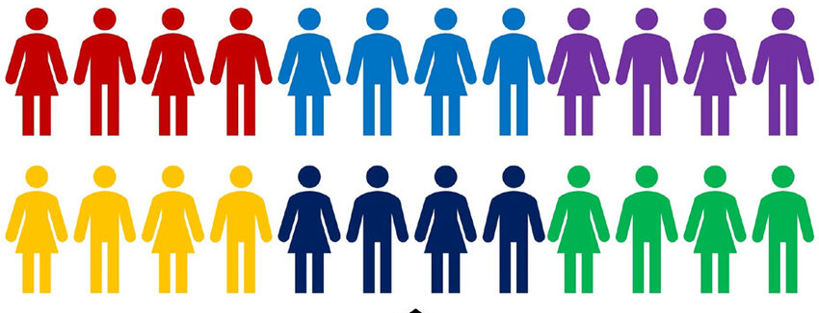
Oregon’s PSO Data Collection
Census: LEA staff collect data by interviewing all leavers in all districts
Response rate was 57.02%,2855 former students, in SY 2022-2023; Average 55.5% for five years prior.
Respondents were representative of target leavers based on:
  Gender, race/ethnicity, geographic location, and disability categories
  Only dropout category was under-represented in the PSO data.
Notes:
Charlotte
(FFY20)

Slide 12


to 31 Districts with 100% Response Rate in 2024 PSO Follow-Up Interviews!
Alsea | Falls City | North Lake
Athena Weston | Fernridge | Oregon Dept. of Corrections
Banks | Fossil | Parkrose
Camas Valley | Gladstone | Pine Eagle
Cove | Glendale | Port Orford
Culver | Huntington | Riddle
Dayville | Imbler | South Wasco
Douglas Co SD15 | Jefferson SD 3 | Vale
Elgin | John Day | Wallowa
Enterprise | McKenzie
Estacada | Myrtle Point
Notes:
Charlotte

Slide 13

these Districts had 95-99% Response Rate in 2024 PSO Follow-Up Interviews!
Canby | West Linn-Wilsonville
Milton-Freewater | Woodburn
Notes:
Charlotte

Slide 14

these Districts with 94-90% Response Rate in 2024 PSO Follow-Up Interviews!
Beaverton | St. Helens
Morrow | Sweet Home
Mt. Angel | Vernonia
Pleasant Hill
Notes:
Charlotte

Slide 15
Oregon: Results for Leavers in SY2022-23
Within one year of leaving high school: | Summer 2023 Interview Data (N = 2866) | Summer 2024 Interview Data (N = 2855) | Summer 2024 Target
Measure A: Enrolled in higher education | 19.6% (561) | 25% (714) | 34%
Measure B: Enrolled in higher education or competitively employed within one year of leaving high school | 64.2% (1850) | 62.2% (1777) | 58%
Measure C: Enrolled in higher education, or in some other post secondary education or training programs, or competitively employed or in some other employment | 74.5% (2135) | 73.7% (2103) | 76% (met target)
Not engaged | 25.5% (731) | 26.3% (752) | NA
Notes:
Charlotte
5007 Students with IEPs
2855 Students Responded to PSO Interview

Slide 16
Notes:
Charlotte

Slide 17
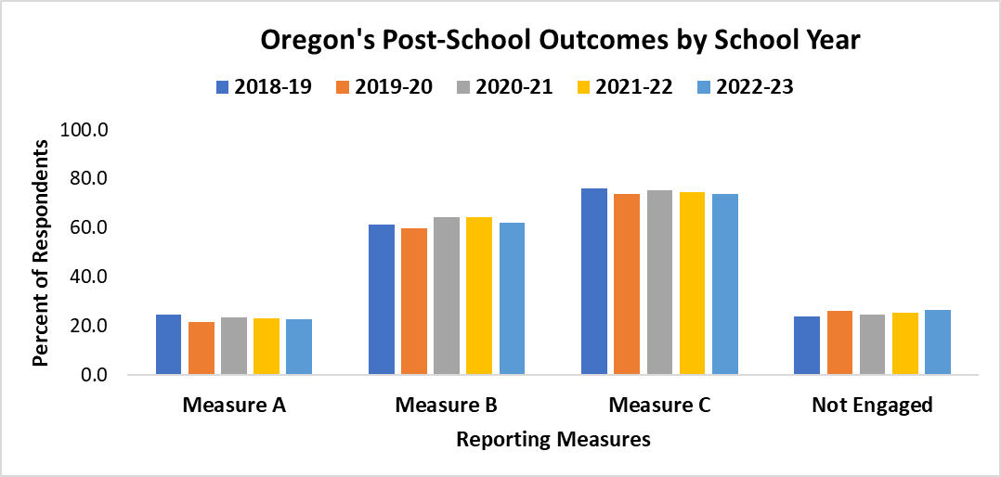
Notes:
Charlotte
Takeaways: In general, Measure A: Higher Ed is trending down;
Measure B: Higher Ed + Competitive Employment is trending up;
Measure C: Higher Ed + Competitive Employment + Postsecondary Education & Training +Other Employment is trending down
Not engaged: is trending up. The 2.5% difference in NE between 2018-19 leavers and 2022-23 leaves is approximately 72 more students not engaged.

Slide 18
Locate Your PSO Data
Notes:
Shava

Slide 19


Post School Outcomes Data Sources
ODE’s Special Education Profiles
PSO App
ODE webpage dedicated to accountability data
Accessible to anyone
District specific data
General data
Online application embedded within ODE’s data collection system.
Must be a PSO data manager to access
Requires approval from District Security Administrator
Detailed data that includes demographics, rates of response, school of attendance.
Notes:
Shava

Slide 20
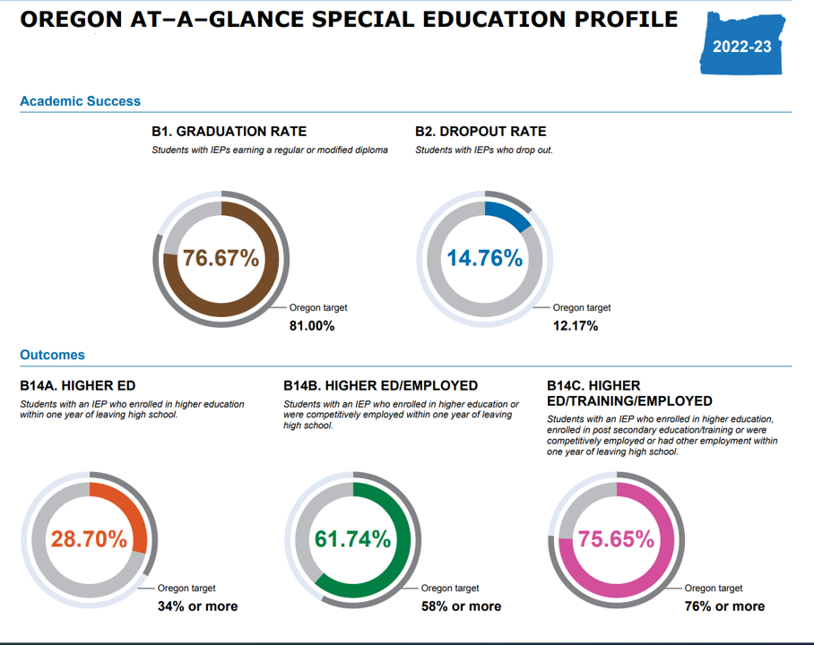
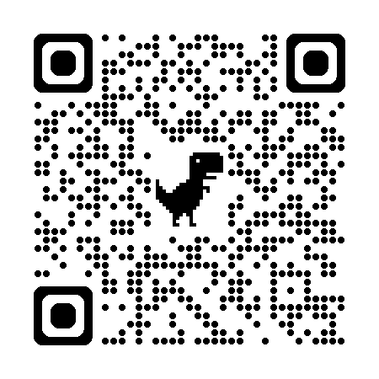
https://www.ode.state.or.us/data/ReportCard/Reports/Index
Notes:
2022-23 Special Education Profile contains data from interviews conducted summer 2023 for students that left school during the 2021-22 school year.

Slide 21

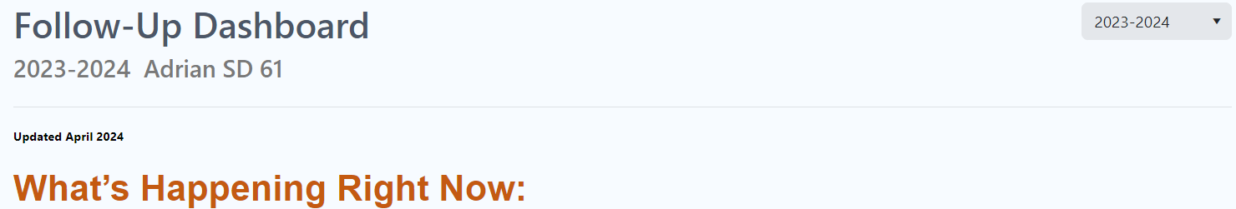

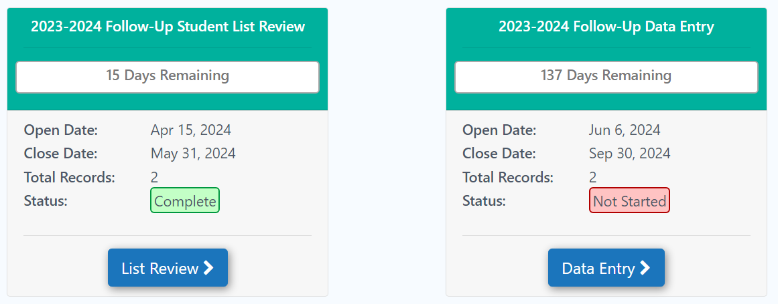

Locate your district within the PSO App
Scroll past the Follow-Up Dashboard for the district
Click on Data Entry in Follow-Up Data Entry window
My SD 411
Notes:
Charlotte

Slide 22
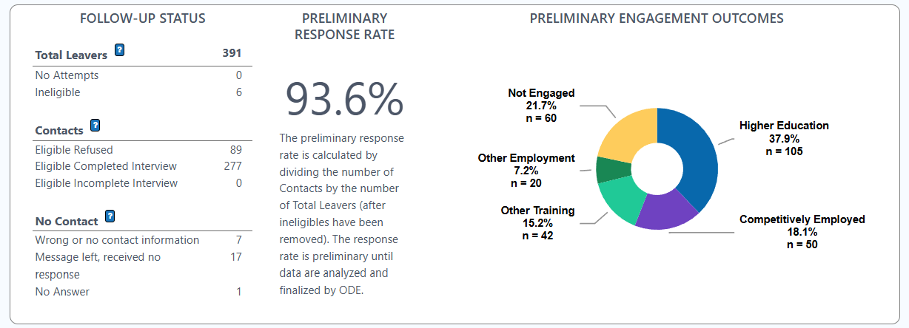
Follow-Up Collection Dashboard
The Follow-Up Collection Dashboard shows the Status of the data collection, the Preliminary Response Rate, and Preliminary Engagement Outcomes.
This information is dynamic throughout data collection. It is preliminary until ODE verifies these data.
Once verified, any adjustments are reflected in the Dashboard
Notes:
Charlotte
The Data Entry button takes you to the Follow-Up Collection Dashboard

Slide 23
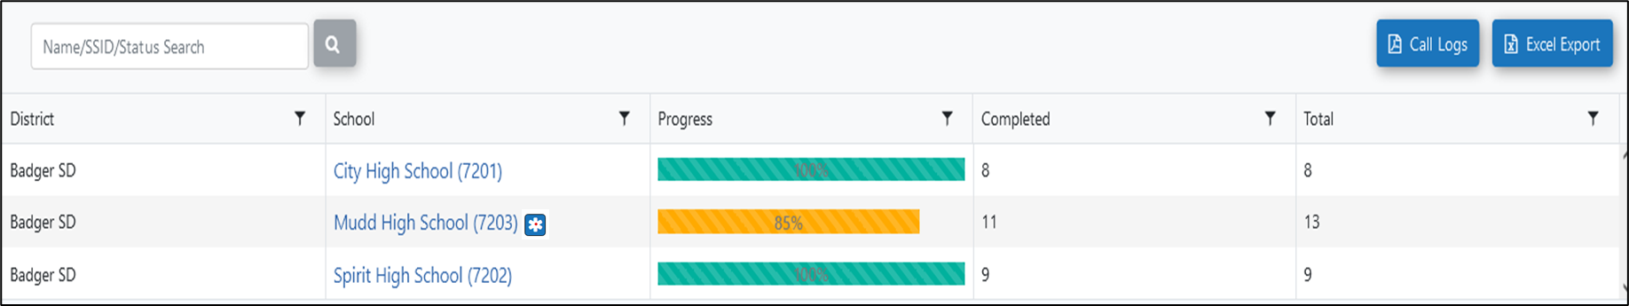
Excel Export
Scroll past the Dashboard and you can export the data using the Excel Export option
Notes:
Charlotte

Slide 24
Interpret State and District-Specific PSO Data
Make Mean or Make Sense of Your PSO Data:
Tell a Story
Notes:
Charlotte

Slide 25
How well do we prepare children with disabilities for further education, employment, and independent living?
Use the Interpreting Your Post-School Outcomes and Oregon PSO Results At-A-Glance resources to
  Compare at your PSO data across multiple years.
  Compare your PSO data to the state data.
Download data from the PSO App and look at how many former students:
  did not attempt to work or enroll in further education after high school; or
  attempted to work or enroll, but did not meet the criteria to for engaged.
Talk with colleagues, and former students, about
  how to raise response rates or get more under-represented students to respond to the interview.
  why former students did not enroll in further education or work
Notes:
Charlotte

Slide 26
How well do we prepare children with disabilities for further education, employment, and independent living?
Look at your PSO data by different demographic groups, such as disability categories, race/ethnicity, method of exit, and gender.
Who is (is not) being prepared?
  Which groups of students are (are not)
    Enrolling in higher education?
    Working in competitive employment?
    Enrolling in other postsecondary education or training?
    Working in some other employment?
    Not engaged?
What is (is not) working and for whom is it (is not) working?
  Which groups of students
    Take and complete career and technical education courses?
    Receive services from VR and or Developmental Disabilities Services?

Slide 27
Tell your PSO data story:
  While in school, many engaged students had these experiences <describe how many participated or completed CTE, had work-based learning experiences, participated in a transition program, developed self-determination skills, etc.>
Notes:
Charlotte

Slide 28
Post-School Outcomes
Outcomes
Higher Education:
Competitive Employment:
Postsecondary Education/Training:
Some Other Employment:
Not Engaged:
Good?
Not so good?
Why or Why Not?
Graduation
How might graduation requirements contribute to the success of your students?
Do all students have work-based learning opportunities?
Drop Out
What might contribute to students dropping out of school?
What could you do differently?
Notes:
Charlotte

Slide 29
Analyze Trends and Gaps
Notes:
Charlotte

Slide 30
What did you learn from your PSO data?
Compare your current PSO results to previous years’ results.
  Are there differences in outcomes from 2022/2023 or 2023/2024?
  How do your district/school outcomes compare to the state’s outcomes?
  Describe any differences you see in the outcomes for different demographic groups.
  Reach out to Shava or Charlotte for more data.
Notes:
Charlotte

Slide 31
Strategies and Resources

Slide 32
Using PSO Data to Improve Transition Services
Questions to Consider Related to Student Outcomes
  How do outcomes this year compare to previous years and to the state outcomes?
  Which student groups are engaged/not engaged?
    Why and why not – what influences engagement of our students?
  How do we provide transition services for all students who receive special education services?
  Are we implementing the strategies that have been shown to predict post-school success?
    Are our students enrolled in career and technical education?
    How do we provide work-based learning opportunities for all students?
    How do we involve parents?
    How do we teach self-advocacy and self-determination?

Slide 33
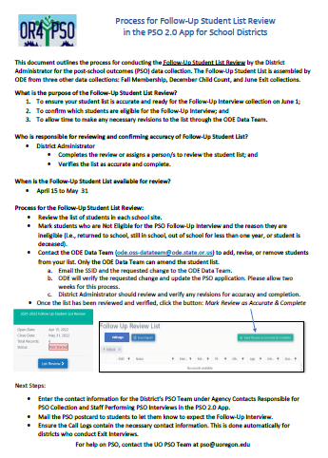
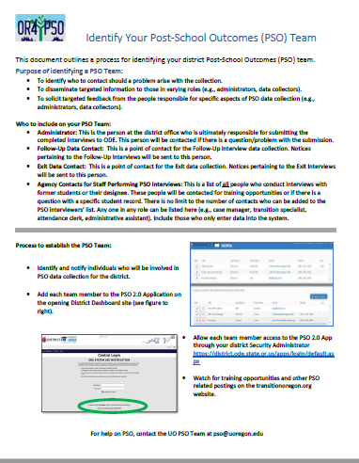
Resources: https://transitionoregon.org
PSO 1-Pagers:
  Identify Your Post-School Outcomes Team
  Process for Follow-Up Student List Review
  What is Consent?/What is a Refusal?
  Capturing Engagement in the Interview
  Understanding Follow-Up Input and Dates
  Advantages of the Exit Interview
Other Resources:
  Education & Training
  Employment
  Independent Living
  Pre-Employment Transition Services
  Self-Determination/Supported Decision Making
  Communication
Notes:
I added some possible new ones

Slide 34

Save the Dates: 2025 PSO Trainings
Date/Time | Audience | Objective | Mode
February The Results are In: PSO Results from 2023 | All interested parties | Share the results from the 2023 PSO data collection efforts | Recorded Only
March 13-14– OSTC - Eugene PSO Session Presentation PSO Info Table with Vendors | Anyone responsible for Post-School Outcomes (PSO) data collection or reporting. | Describe PSO processes | LIVE at Conference
April 12 Ready, Set, Go for PSO: Take a Dive into PSO 2025 | Data collectors & administrators collecting and reporting PSO data | Provide an overview of PSO processes, timeline, and resources for 2025 | Recorded Only
May 20 - @2:00 PM (PDT) ODE Spring Training Webinar | By ODE invitation only – watch for notification |  | LIVE-Virtual
May Why Does It Matter: What, Why, When and Who | All interested parties Registration required – watch for notification | How to use PSO Data to inform programs | Recorded Only
June 13 - @3:00-4:00 PM (PDT) and August 15 - @3:00-4:00 PM (PDT) Open Mic Q & A | Anyone affiliated with PSO Registration required – watch for notification | Open Q & A Discussion regarding Oregon PSO | LIVE and Recorded
Up-to-date training information will be posted on the ODE PSO 2.0 App Main Dashboard Links to recorded sessions and PSO Resources are located under the PSO Resources tab: https://transitionoregon.org/post-school-outcomes/
Notes:
2025 revisions

Slide 35

Student List Review will be available mid-April
PSO App 2.0
  Opens first Thursday in June – 6/6/25
  Closes last Monday in September – 9/29/25

Slide 36

Contact Us
For help with PSO questions or technical issues please contact:
Shava Feinstein, shava.feinstein@ode.oregon.gov
Charlotte Alverson, calverso@uoregon.edu
pso@uoregon.edu

Slide 37
Additional Data
The following slides contain additional data that you may be interested in reviewing. See the notes in each slide for details. If you have questions, or need help with your data, reach out to Shava Feinstein, shava.feinstein@ode.oregon.gov or Charlotte Alverson, calverso@uoregon.edu

Slide 38
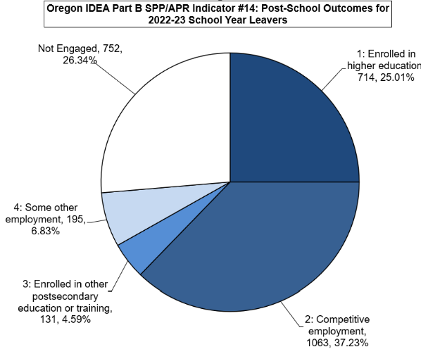
Oregon’s PSO Results for School Year 22-23
Total Former Student Leavers
  5,007
Total Respondents
  2,855 (52.7%)
Total Engaged
  2,103 (73.66%)
Not Engaged
  752 (26.34%)
Notes:
Summary of PSO Results
Year Total Leavers Total Respondents Total Engaged Not Engaged
FFY20 4847 2775 2001 (72%) 774
FFY21 4601 2782 2100 (75.5%) 682
FFY22 5435 2866 2135 (74.5%) 734
FFY23 5007 2855 2103 (73.66%) 752

Slide 39
5 Numbers 3 Engagement Rates A, B, C
Five outcome categories are combined into three engagement measures
1 = # Higher Education | 2 = # Competitive Employment | 3 = # Postsecondary Education or Training | 4 = # Some Other Employment | 5 = # Other or Not Engaged (States are not required to report this number, but it is in the denominator.)
A = 1/Total Respondents
B = 1 + 2 / Total Respondents
C = 1 + 2 + 3 + 4 /Total Respondents
Total Respondents
Notes:
The five outcome categories are combined into the three reporting measures: Measure A, Measure B, and Measure C.
This slide shows the formula for calculating the measures

Slide 40
Historical Engagement/Not Engagement
Notes:
This slide shows Oregon’s Historical engaged and not engaged percentages for the past 15 years.

Slide 41
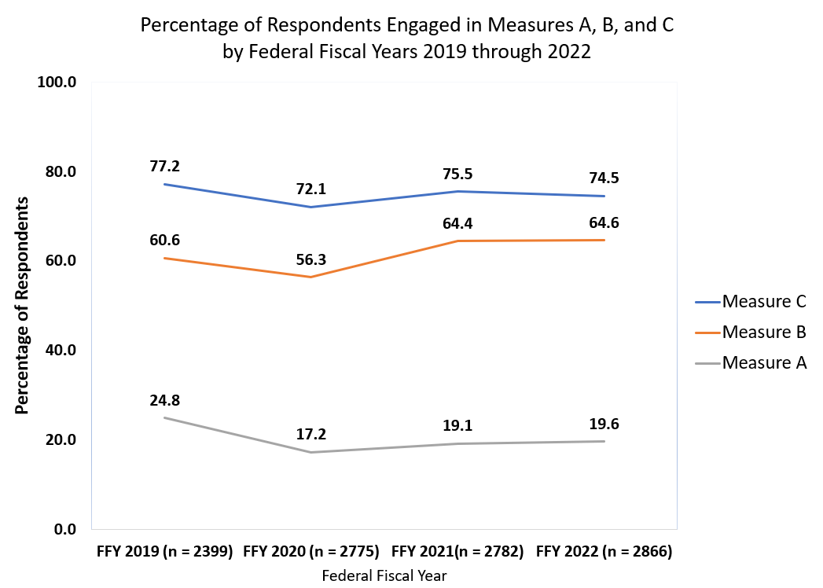
Notes:
This slides shows the percentage of respondents who were engaged in the three Measures A, B, & C for the for the last four years.
Federal fiscal year corresponds to the spring of the school year. For example, FFY2019 is school year 2018-19 and reflects former students who exited school in 2018-19 school year.

Slide 42
Oregon’s Response Rate by School Year
Notes:
This slides shows the response rates for the five years.

Slide 43
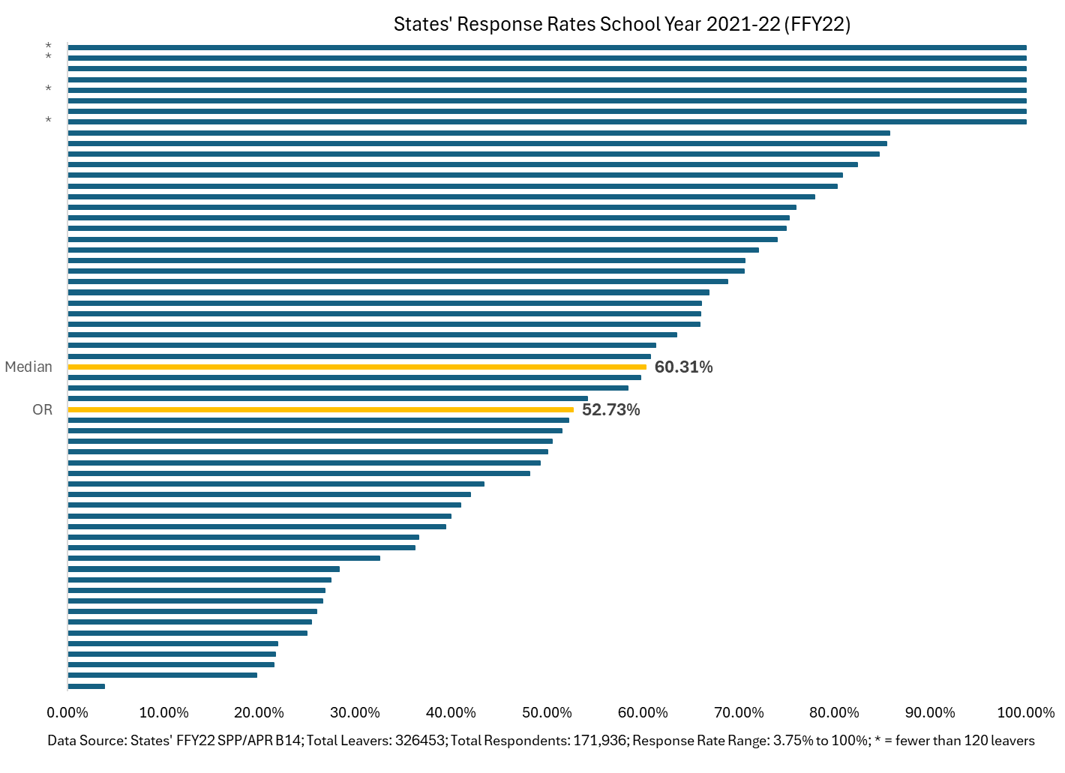
Oregon’s Response Rate for leavers in school year 2021-22 compared to the national median response rate and the other 59 states & territories
Oregon’s Response Rate increased to 57.02% for leavers in school year 2022-23
Notes:
This slide shows how Oregon’s response rate compares to the other states and territories.

Slide 44
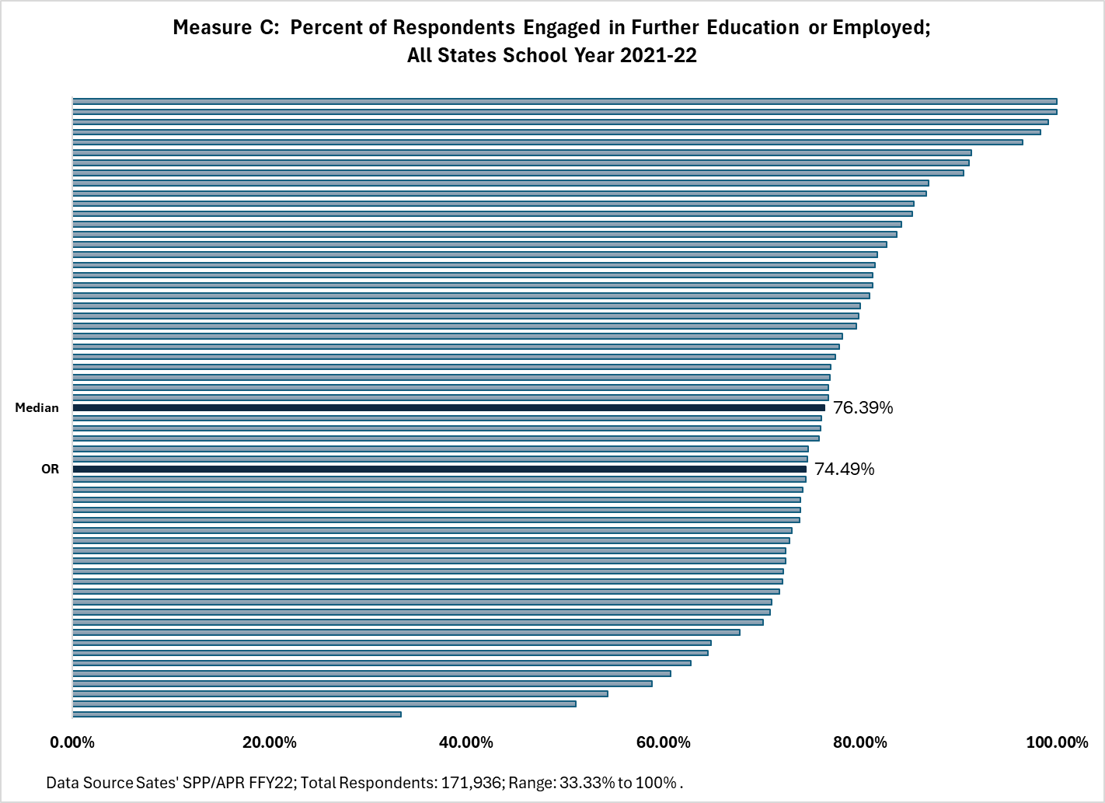
Oregon’s Measure C in School Year 2021-22 compared to the national median and the other 59 states and territories.
Notes:
This slide shows how Oregon’s engagement rate (Measure C) compares to the other states and territories.

Slide 45
Increasing Response Rates
Respondents
  How are potential respondents notified about the survey/interview?
    Post-card, email, flyer, letter
  Who is (and is not) responding – former students; parent/family
Questions
  Asked rotely or as a conversation?
  Do respondents understand the question (language and vocabulary)?
Interview
  Who conducts interviews – preferred person; person known to the former student?
  How are interviewers trained?
  When are attempts made to collect data: over multiple days and times
Notes:
Considerations for increasing response rates

Slide 46
Representation/Representativeness
Representativeness means that a subgroup of individuals (i.e., respondents) mirrors the larger group (i.e., all leavers) on important demographic characteristics.
  Those who responded to the interview are like the population of total leavers on key demographic characteristics
Oregon examines PSO results by: race/ethnicity, gender, disability, geographic location, exit method, and language
Notes:
Considerations for increasing representation

Slide 47


Do you trust your data?
What do you need in order to trust your data?
Notes:
Ask your PSO team, do you trust your data and if the answer is know, what do you need in order to trust your data? Do you need more data? Do you need to have specific questions answered?

Slide 48
PSO Response Rate & Representation
What was the response rate?
How well are all students represented?
Good?
Not so good?
Why or Why Not?
When are former students contacted?
Who contacts former students?
How many times do you attempt to contact former students?
Student Groups Not Represented
If students or families are non-English speakers, do you use interpreters or send information home in a language other than English?
Are multiple contacts collected for each student?
Is the Exit Interview conducted?
What could you do differently?
Notes:
Use this graphic organizer to think about ways to increase response rates and representation in your respondents.

Slide 49
Using PSO Data to Increase Response Rates
Questions to Consider Related to Data Quality
  What was our response rate and was it better or worse than last year?
    Are interviewers making multiple attempts on multiple days and at different times to reach former students?
    Are interviewers conducting an optional Exit Interview before the student leaves school?
  How representative were respondents compared to total leavers?
    Which student group is not responding to the interview?
    How can we get our students who dropout of school to respond to the interview?
    Are we getting multiple forms of contact information?
  When do we tell students and families about the interview?
  Who conducts the interviews?
  How can we improve data quality?
Notes:
Consider these questions when using your PSO data to increase or improve response rates

Slide 50
Predictors of Post-School Success
Program of Study
Psychological Empowerment*
Self-Advocacy/Self-Determination
Self-Care/Independent Living
Self-Realization*
Social Skills
Student Support
Technology Skills*
Transition Program
Travel Skills*
Work Study
Youth Autonomy/Decision Making*
Career Awareness
Career and Technical Education (i.e., vocational ed)
Community Experiences
Exit Exam Requirements/High School Diploma Status
Goal Setting*
Inclusion in General Education
Interagency Collaboration
Occupational Courses
Paid Employment/Work Experience
Parent Expectations
Parental Involvement*
Note: * newest predictors; to be defined
Notes:
To think about improving outcomes for students, link the reasons former students are not meeting the criteria for engagement to the 23 predictors of post-school success.
For example, how many former students enrolled in further education or worked since leaving high school, but did n ot meet the criteria for being engaged in an outcome category. Was it because they…
… enrolled in further education and did not complete a term?
… did not work for at least 90 Days?
… worked but made less than minimum wage?
… did not work an average of 20 hours per week?
… did not work in an integrated employment environment?
Which of the 23 predictors might help students complete one term of further education (e.g., do students need self-advocacy/self-determination skills; do they need self-care/independent living skills; would they benefit from goal setting)?

Slide 51
Tell your PSO data story regarding response rates and representation:
  In 2022-23, we had <number> former students eligible for the PSO Follow-Up Interview. Of these, <number, percent> completed the interviews for a response rate of <percent>. This response rate is <higher/lower> than the state’s rate of <X percent> and <higher/lower> than our response rate of <percent> for students who left school in 2021-22. Our PSO data <are/are not> representative of students based on <race/ethnicity, gender, disability, geographic location, exit method, and language>. To raise our response rate, we could <strategies>. To increase representation from under-represented groups, we could <strategies>.
Notes:
A guide for telling your data story regarding response rates and representation.

